Slide 1

CS 456/656
Computer Networks
Lecture 17: Naming and Addressing
Mina Tahmasbi Arashloo and Uzma Maroof
Fall 2025

Slide 2

A note on the slides
Adapted from the slides that accompany this book.
All material copyright 1996-2023
J.F Kurose and K.W. Ross, All Rights Reserved
Computer Networking: A Top-Down Approach
8th edition
Jim Kurose, Keith Ross
Pearson, 2020

Slide 3







Naming and Addressing
If host A wants to communicate with host B
A and B each should have an interface connecting them to their LAN.
Each interface should have an IP address and a MAC address.
To send data to B, A should create a packet with the following addresses:
A
R
Source IP ${IP}_{A}$
Source MAC ${MAC}_{A}$
B
Destination IP $IP_{B}$
Destination MAC $MAC_{B}$
$A$ and $B$ are in the same LAN

Slide 4





Naming and Addressing
If host A wants to communicate with host B
A and B each should have an interface connecting them to their LAN.
Each interface should have an IP address and a MAC address.
To send data to B, A should create a packet with the following addresses:
A
R
B
Source IP ${IP}_{A}$
Source MAC ${MAC}_{A}$
Destination IP $IP_{B}$
Destination MAC $MAC_{B}$
First-hop router IP $IP_{R}$
First-hop router MAC $MAC_{R}$
$A$ and $B$ are in different LANs

Slide 5
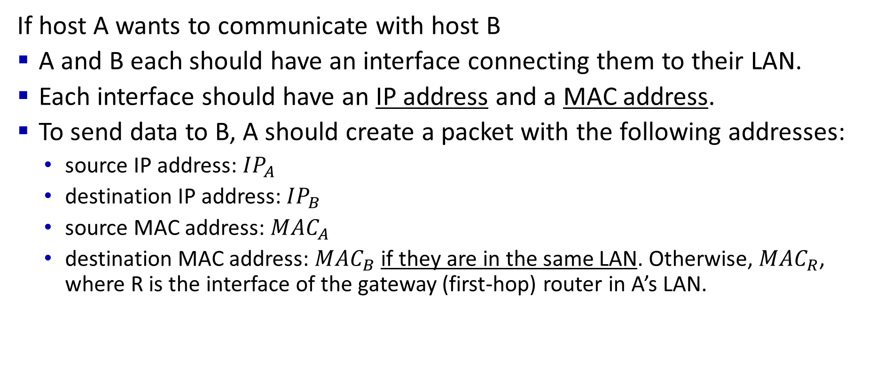
Naming and Addressing
If host A wants to communicate with host B
A and B each should have an interface connecting them to their LAN.
Each interface should have an IP address and a MAC address.
To send data to B, A should create a packet with the following addresses:
  source IP address: $IP_{A}$
  destination IP address: $IP_{B}$
  source MAC address: $MAC_{A}$
  destination MAC address: $MAC_{B}$ if they are in the same LAN. Otherwise, $MAC_{R}$, where R is the interface of the gateway (first-hop) router in A’s LAN.

Slide 6
Naming and Addressing
If host A wants to communicate with host B
A and B each should have an interface connecting them to their LAN.
Each interface should have an IP address and a MAC address.
To send data to B, A should create a packet with the following addresses:
  source IP address: $IP_{A}$
  destination IP address: $IP_{B}$
  source MAC address: $MAC_{A}$
  destination MAC address: $MAC_{B}$ if they are in the same LAN. Otherwise, $MAC_{R}$, where R is the interface of the gateway (first-hop) router in A’s LAN.
This Lecture: How does A find these addresses?

Slide 7
Naming and Addressing
If host A wants to communicate with host B
A and B each should have an interface connecting them to their LAN.
Each interface should have an IP address and a MAC address.
To send data to B, A should create a packet with the following addresses:
  source IP address: $IP_{A}$
  destination IP address: $IP_{B}$
  source MAC address: $MAC_{A}$
  destination MAC address: $MAC_{B}$ if they are in the same LAN. Otherwise, $MAC_{R}$, where R is the interface of the gateway (first-hop) router in A’s LAN.
Comes with the interface

Slide 8
Naming and Addressing
If host A wants to communicate with host B
A and B each should have an interface connecting them to their LAN.
Each interface should have an IP address and a MAC address.
To send data to B, A should create a packet with the following addresses:
  source IP address: $IP_{A}$
  destination IP address: $IP_{B}$
  source MAC address: $MAC_{A}$
  destination MAC address: $MAC_{B}$ if they are in the same LAN. Otherwise, $MAC_{R}$, where R is the interface of the gateway (first-hop) router in A’s LAN.
Comes with the interface
Through ARP. But has to know B’s (or R’s) IP address.

Slide 9
Naming and Addressing
If host A wants to communicate with host B
A and B each should have an interface connecting them to their LAN.
Each interface should have an IP address and a MAC address.
To send data to B, A should create a packet with the following addresses:
  source IP address: $IP_{A}$
  destination IP address: $IP_{B}$
  source MAC address: $MAC_{A}$
  destination MAC address: $MAC_{B}$ if they are in the same LAN. Otherwise, $MAC_{R}$, where R is the interface of the gateway (first-hop) router in A’s LAN.
How does A get an IP address ??
Comes with the interface
Through ARP. But has to know B’s (or R’s) IP address.

Slide 10
Naming and Addressing
If host A wants to communicate with host B
A and B each should have an interface connecting them to their LAN.
Each interface should have an IP address and a MAC address.
To send data to B, A should create a packet with the following addresses:
  source IP address: $IP_{A}$
  destination IP address: $IP_{B}$
  source MAC address: $MAC_{A}$
  destination MAC address: $MAC_{B}$ if they are in the same LAN. Otherwise, $MAC_{R}$, where R is the interface of the gateway (first-hop) router in A’s LAN.
How does A get an IP address ??
How does A find B’s (or R’s) IP address?
Comes with the interface
Through ARP. But has to know B’s (or R’s) IP address.

Slide 11
Naming and Addressing: roadmap
DHCP
  Helps A find an IP address
  Helps A find the IP address of the gateway router
DNS
  Helps A find B’s IP address

Slide 12
Naming and Addressing: roadmap
DHCP
  Helps A find an IP address
  Helps A find the IP address of the gateway router
DNS
  Helps A find B’s IP address

Slide 13
DHCP: Dynamic Host Configuration Protocol
goal: host dynamically obtains IP address from network server when it “joins” network
  can renew its lease on address in use
  allows reuse of addresses (only hold address while connected/on)
  support for mobile users who join/leave network
DHCP overview:
  host broadcasts DHCP discover msg [optional]
  DHCP server responds with DHCP offer msg [optional]
  host requests IP address: DHCP request msg
  DHCP server sends address: DHCP ack msg
Notes:
ICANN (Internet Corporation for Assigned Names and Numbers)
Allocating IP address
Managing DNS root servers

Slide 14




DHCP client-server scenario
Typically, DHCP server will be co-located in router, serving all subnets to which router is attached
DHCP server
223.1.1.1
223.1.2.1
223.1.2.5
223.1.1.2
223.1.1.4
223.1.2.9
223.1.1.3
223.1.3.27
arriving DHCP client needs
address in this network
223.1.2.2
223.1.3.1
223.1.3.2

Slide 15


DHCP client-server scenario
DHCP server: 223.1.2.5
DHCP discover
Arriving client
src : 0.0.0.0, 68
dest.: 255.255.255.255,67
yiaddr: 0.0.0.0
transaction ID: 654
Broadcast: is there a DHCP server out there?
DHCP offer
src: 223.1.2.5, 67
dest: 255.255.255.255, 68
yiaddr: 223.1.2.4
transaction ID: 654
lifetime: 3600 secs
Broadcast: I’m a DHCP server! Here’s an IP address you can use
The two steps above can be skipped “if a client remembers and wishes to reuse a previously allocated network address” [RFC 2131]
DHCP request
src: 0.0.0.0, 68
dest:: 255.255.255.255, 67
yiaddr: 223.1.2.4
transaction ID: 655
lifetime: 3600 secs
Broadcast: OK. I would like to use this IP address!
DHCP ACK
src: 223.1.2.5, 67
dest: 255.255.255.255, 68
yiaddr: 223.1.2.4
transaction ID: 655
lifetime: 3600 secs
Broadcast: OK. You’ve got that IP address!

Slide 16
DHCP: more than IP addresses
DHCP can return more than just allocated IP address on subnet:
  address of first-hop router for client
  name and IP address of DNS sever
    Which we will learn about next
  network mask (indicating network versus host portion of address)

Slide 17


DHCP: example
DHCP
DHCP
UDP
IP
Eth
Phy
Connecting laptop will use DHCP to get IP address, address of first-hop router, address of DNS server.
DHCP
DHCP
DHCP
DHCP
DHCP REQUEST message encapsulated in UDP, encapsulated in IP, encapsulated in Ethernet
DHCP
DHCP
UDP
IP
Eth
Phy
168.1.1.1
DHCP
DHCP
DHCP
Ethernet frame broadcast (dest: FFFFFFFFFFFF) on LAN, received at router running DHCP server
DHCP
router with DHCP
server built into
router
Ethernet de-mux’ed to IP de-mux’ed, UDP de-mux’ed to DHCP

Slide 18
DHCP: example
DHCP
UDP
IP
Eth
Phy
DHCP server formulates DHCP ACK containing client’s IP address, IP address of first-hop router for client, name & IP address of DNS server
DHCP
DHCP
DHCP
DHCP
encapsulated DHCP server reply forwarded to client, de-muxing up to DHCP at client
DHCP
DHCP
UDP
IP
Eth
Phy
DHCP
DHCP
DHCP
router with DHCP
server built into
router
client now knows its IP address, name and IP address of DNS server, IP address of its first-hop router
DHCP

Slide 19

Naming and Addressing
If host A wants to communicate with host B
A and B each should have an interface connecting them to their LAN.
Each interface should have an IP address and a MAC address.
To send data to B, A should create a packet with the following addresses:
  source IP address: $IP_{A}$
  destination IP address: $IP_{B}$
  source MAC address: $MAC_{A}$
  destination MAC address: $MAC_{B}$ if they are in the same LAN. Otherwise, $MAC_{R}$, where R is the interface of the gateway router in A’s LAN.
How does A get an IP address ??
How does A find B’s (or R’s) IP address?
Comes with the interface
Through ARP. But has to know B’s (or R’s) IP address.

Slide 20
Naming and Addressing
If host A wants to communicate with host B
A and B each should have an interface connecting them to their LAN.
Each interface should have an IP address and a MAC address.
To send data to B, A should create a packet with the following addresses:
  source IP address: $IP_{A}$
  destination IP address: $IP_{B}$
  source MAC address: $MAC_{A}$
  destination MAC address: $MAC_{B}$ if they are in the same LAN. Otherwise, $MAC_{R}$, where R is the interface of the gateway router in A’s LAN.
How does A get an IP address ?? DHCP
How does A find B’s (or R’s) IP address?
Comes with the interface
Through ARP. But has to know B’s (or R’s) IP address.

Slide 21
What you need to know about DHCP
The purpose of the protocol
The protocol’s basic operations, i.e., the messages and information exchanged when a host wants to acquire an IP address.
  E.g., given a scenario where a host (re)joins a LAN, you should be able to fill out the basic information inside the exchanged messages.
The extra information that DHCP provide for hosts to bootstrap their network configurations.

Slide 22
Naming and Addressing: roadmap
DHCP
  Helps A find an IP address
  Helps A find the IP address of the gateway router
DNS
  Helps A find B’s IP address

Slide 23
DNS: Domain Name System
people: many identifiers:
  SIN, name, passport #
Internet hosts, routers:
  IP address (32 bit) - used for addressing datagrams in the network layer.
  “name”, e.g., cs.umass.edu - used by humans

Slide 24
DNS: Domain Name System
people: many identifiers:
  SIN, name, passport #
Internet hosts, routers:
  IP address (32 bit) - used for addressing datagrams in the network layer.
  “name”, e.g., cs.umass.edu - used by humans
Human readable
Much easier to remember
IP addresses may change but this doesn’t have to change

Slide 25
DNS: Domain Name System
people: many identifiers:
  SIN, name, passport #
Internet hosts, routers:
  IP address (32 bit) - used for addressing datagrams in the network layer.
  “name”, e.g., cs.umass.edu - used by humans
Q: how to map from a name to an IP address?

Slide 26
DNS: Domain Name System
people: many identifiers:
  SIN, name, passport #
Internet hosts, routers:
  IP address (32 bit) - used for addressing datagrams in the network layer.
  “name”, e.g., cs.umass.edu - used by humans
Q: how to map from a name to an IP address?
Domain Name System (DNS):
Database that keeps the mapping between names and IP addresses
Implemented in a distributed manner over a hierarchy of name servers
application-layer protocol: hosts and DNS servers communicate to resolve names (address/name translation)
  DNS is core Internet function, implemented as application-layer protocol

Slide 27
DNS: a distributed, hierarchical database
Root DNS Servers
Root
…
…
.com DNS servers
.org DNS servers
.edu DNS servers
Top Level Domain
…
…
…
…
yahoo.com
DNS servers
amazon.com
DNS servers
pbs.org
DNS servers
nyu.edu
DNS servers
umass.edu
DNS servers
Authoritative
Client wants IP address for www.amazon.com:
client queries root server to find .com DNS server
client queries .com DNS server to get amazon.com DNS server
client queries amazon.com DNS server to get IP address for www.amazon.com

Slide 28
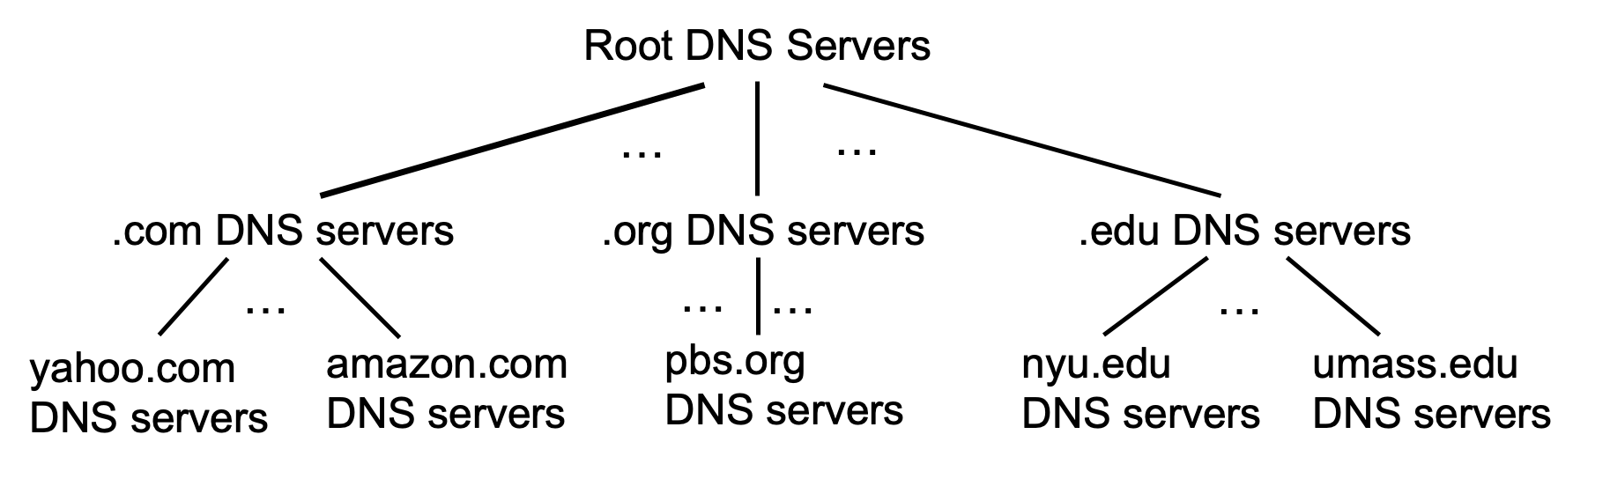
DNS: root name servers
Provides the IP address of Top-Level-Domain (TLD) servers
  Right below it in the tree
They are where one goes to get the translations started.

Slide 29
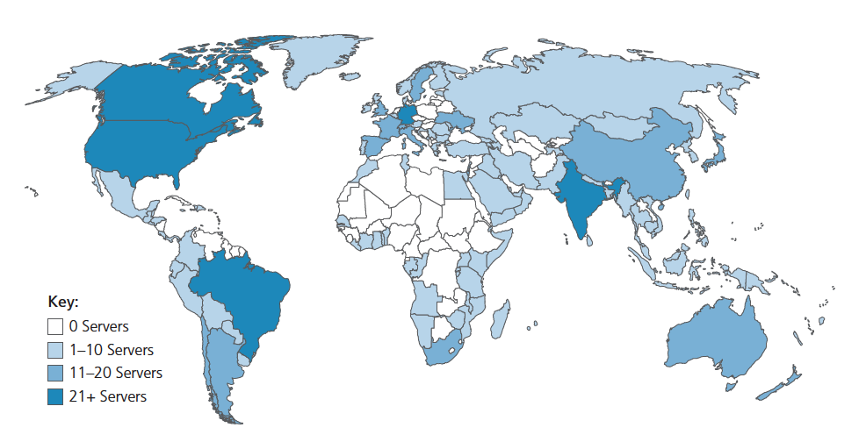
DNS: root name servers
incredibly important Internet function
  Internet couldn’t function without it!
ICANN (Internet Corporation for Assigned Names and Numbers) manages root DNS domain
13 logical root name “servers” worldwide each “server” replicated many times (~200 servers in US)

Slide 30
Top-Level Domain, and authoritative servers
Top-Level Domain (TLD) servers:
  responsible for names under .com, .org, .net, .edu, .aero, .jobs, .museums, and all top-level country domains, e.g.: .cn, .uk, .fr, .ca, .jp
  Network Solutions: authoritative registry for .com, .net TLD
  Educause: .edu TLD
authoritative DNS servers:
  organization’s own DNS server(s), providing authoritative hostname to IP mappings for organization’s named hosts
  can be maintained by organization or service provider

Slide 31
DNS name resolution
root DNS server
Example: host at engineering.nyu.edu wants IP address for gaia.cs.umass.edu
TLD DNS server
requesting host at
engineering.nyu.edu
local DNS server
dns.nyu.edu
gaia.cs.umass.edu
authoritative DNS server
dns.cs.umass.edu

Slide 32
Local DNS name servers
when host makes DNS query, it is sent to its local DNS server
  Local DNS server returns reply, answering:
    from its local cache of recent name-to-address translation pairs
    forwarding request into DNS hierarchy for resolution if not in cache
  each ISP has local DNS name server; to find yours:
    MacOS: % scutil --dns
    Windows: >ipconfig /all
local DNS server doesn’t strictly belong to hierarchy

Slide 33
DNS name resolution: iterative query
root DNS server
Example: host at engineering.nyu.edu wants IP address for gaia.cs.umass.edu
2
3
TLD DNS server
Iterative query:
contacted server replies with name of server to contact
“I don’t know this name, but ask this server”
1
4
8
5
requesting host at
engineering.nyu.edu
local DNS server
dns.nyu.edu
gaia.cs.umass.edu
7
6
authoritative DNS server
dns.cs.umass.edu

Slide 34
DNS name resolution: recursive query
root DNS server
Example: host at engineering.nyu.edu wants IP address for gaia.cs.umass.edu
2
3
7
6
Recursive query:
puts burden of name resolution on contacted name server
heavy load at upper levels of hierarchy?
1
TLD DNS server
8
requesting host at
engineering.nyu.edu
local DNS server
dns.nyu.edu
5
4
gaia.cs.umass.edu
authoritative DNS server
dns.cs.umass.edu

Slide 35
DNS records
DNS: distributed database storing resource records (RR)
RR format: (name, value, type, ttl)
type=A
  name is hostname
  value is IP address
type=CNAME
  name is alias name for some “canonical” (the real) name
  www.ibm.com is really servereast.backup2.ibm.com
  value is canonical name
type=NS
  name is domain (e.g., foo.com)
  Value is hostname of authoritative name server for this domain or a name server for a domain that includes the hostname
type=MX
  value is name of SMTP mail server associated with name

Slide 36
Example of records
root DNS server
IP address: 8.5.1.4
TLD DNS server
IP address: 15.3.120.4
requesting host at
engineering.nyu.edu
local DNS server
dns.nyu.edu
gaia.cs.umass.edu
IP address: 128.119.245.12
authoritative DNS server
dns.cs.umass.edu
IP address: 17.18.19.3

Slide 37
Example of records
root DNS server
IP address: 8.5.1.4
TLD DNS server
IP address: 15.3.120.4
requesting host at
engineering.nyu.edu
local DNS server
dns.nyu.edu
gaia.cs.umass.edu
IP address: 128.119.245.12
(gaia.cs.umass.edu, 128.119.245.12, A, 30)
authoritative DNS server
dns.cs.umass.edu
IP address: 17.18.19.3

Slide 38
Example of records
root DNS server
IP address: 8.5.1.4
TLD DNS server
IP address: 15.3.120.4
(cs.umass.edu, dns.cs.umass.edu, NS, 60)
(dns.cs.umass.edu, 17.18.19.3, A, 60)
requesting host at
engineering.nyu.edu
local DNS server
dns.nyu.edu
gaia.cs.umass.edu
IP address: 128.119.245.12
authoritative DNS server
dns.cs.umass.edu
IP address: 17.18.19.3

Slide 39
Example of records
root DNS server
IP address: 8.5.1.4
(edu, <hostname for .edu TLD>, NS, 60)
(<hostname for .edu TLD>, 15.3.120.4, A, 60)
TLD DNS server
IP address: 15.3.120.4
requesting host at
engineering.nyu.edu
local DNS server
dns.nyu.edu
gaia.cs.umass.edu
IP address: 128.119.245.12
authoritative DNS server
dns.cs.umass.edu
IP address: 17.18.19.3

Slide 40
DNS protocol messages
DNS query and reply messages, both have same format:
2 bytes
2 bytes
message header:
identification: 16 bit # for query, reply to query uses same #
flags:
  query or reply
  recursion desired
  recursion available
  reply is authoritative
identification
flags
# questions
# answer RRs
# authority RRs
# additional RRs
questions (variable # of questions)
answers (variable # of RRs)
authority (variable # of RRs)
additional info (variable # of RRs)

Slide 41
DNS protocol messages
DNS query and reply messages, both have same format:
2 bytes
2 bytes
identification
flags
# questions
# answer RRs
# authority RRs
# additional RRs
name, type fields for a query
questions (variable # of questions)
RRs in response to query
answers (variable # of RRs)
records for authoritative servers
authority (variable # of RRs)
additional “ helpful” info that may be used
additional info (variable # of RRs)

Slide 42
Caching DNS Information
once (any) name server learns mapping, it caches mapping, and immediately returns a cached mapping in response to a query
  caching improves response time
  cache entries timeout (disappear) after some time (TTL)
  TLD servers typically cached in local name servers
cached entries may be out-of-date
  if named host changes IP address, may not be known Internet-wide until all TTLs expire!
  best-effort name-to-address translation!

Slide 43
Getting your info into the DNS
example: new startup “Network Utopia”
register name networkuptopia.com at DNS registrar (e.g., Network Solutions)
  provide names, IP addresses of authoritative name server (primary and secondary)
  registrar inserts NS, A RRs into .com TLD server:
  (networkutopia.com, dns1.networkutopia.com, NS)
  (dns1.networkutopia.com, 212.212.212.1, A)
create authoritative server locally with IP address 212.212.212.1
  type A record for www.networkuptopia.com
  type MX record for networkutopia.com

Slide 44
DNS security
DDoS attacks
bombard root servers with traffic
  not successful to date
  traffic filtering
  local DNS servers cache IPs of TLD servers, allowing root server bypass
bombard TLD servers
  potentially more dangerous
Spoofing attacks
intercept DNS queries, returning bogus replies
  DNS cache poisoning
  RFC 4033: DNSSEC authentication services

Slide 45
DNS: services, structure
DNS services:
hostname-to-IP-address translation
host aliasing
  canonical, alias names
mail server aliasing
load distribution
  replicated Web servers: many IP addresses correspond to one name
Q: Why not centralize DNS?
single point of failure
traffic volume
distant centralized database
maintenance
A: doesn‘t scale!
Comcast DNS servers alone: 600B DNS queries/day
Akamai DNS servers alone: 2.2T DNS queries/day

Slide 46

Final thoughts about the DNS
humongous distributed database:
~ billion records, each simple
handles many trillions of queries/day:
many more reads than writes
performance matters: almost every Internet transaction interacts with DNS - msecs count!
organizationally, physically decentralized:
millions of different organizations responsible for their records
Needs to be reliable and secure

Slide 47
What you need to know about DNS
DNS is a very important protocol so almost everything we have discussed is important to know. This includes but is not limited to
The purpose of DNS and the details of how it operates
How DNS name servers are structured
Various DNS records and what they are used for
The difference between local DNS name servers and other name servers and how they interact
Various ways for a DNS query to be resolved.
Being able to fill out details the steps in resolving DNS queries (including the order in which they happen) and DNS records at various name servers
…

Slide 48
Naming and Addressing
If host A wants to communicate with host B
A and B each should have an interface connecting them to their LAN.
Each interface should have an IP address and a MAC address.
To send data to B, A should create a packet with the following addresses:
  source IP address: $IP_{A}$
  destination IP address: $IP_{B}$
  source MAC address: $MAC_{A}$
  destination MAC address: $MAC_{B}$ if they are in the same LAN. Otherwise, $MAC_{R}$, where R is the interface of the gateway router in A’s LAN.
How does A get an IP address ?? DHCP
How does A find B’s (or R’s) IP address?
B’s IP address: DNS, R’s IP address: DHCP
Comes with the interface
Through ARP. But has to know B’s (or R’s) IP address.

Slide 49
Naming and Addressing: roadmap
DHCP
  Helps A find an IP address
  Helps A find the IP address of the gateway router
DNS
  Helps A find B’s IP address

Slide 50
Bringing it all together
We have covered (almost) all the main layers of a network stack!
We have also covered important protocols that help with naming and addressing.
When you come to campus, open your laptop, connect to the network, and type “www.google.com” in the browser…
All of these protocols have to work together under the hood before you can actually see google’s landing page ☺
Let’s walk through a (very important) example

Slide 51
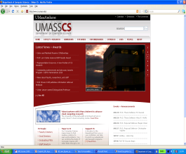


A day in the life: scenario
scenario:
DNS server
arriving mobile client attaches to network …
browser
Comcast network
68.80.0.0/13
requests web page: www.google.com
school network
68.80.2.0/24
web page
Sounds
simple!
web server
Google’s network
64.233.160.0/19
64.233.169.105

Slide 52
A day in the life: connecting to the Internet
DHCP
DHCP
UDP
IP
Eth
Phy
connecting laptop needs to get its own IP address, addr of first-hop router, addr of DNS server: use DHCP
DHCP
DHCP
DHCP
arriving mobile:
DHCP client
DHCP
DHCP request encapsulated in UDP, encapsulated in IP, encapsulated in 802.3 Ethernet
DHCP
DHCP
UDP
IP
Eth
Phy
DHCP
DHCP
DHCP
DHCP
Ethernet frame broadcast (dest: FFFFFFFFFFFF) on LAN, received at router running DHCP server
router has
DHCP server
Ethernet de-muxed to IP de-muxed, UDP de-muxed to DHCP

Slide 53
A day in the life: connecting to the Internet
DHCP
UDP
IP
Eth
Phy
DHCP server formulates DHCP ACK containing client’s IP address, IP address of first-hop router for client, name & IP address of DNS server
DHCP
DHCP
DHCP
arriving mobile:
DHCP client
DHCP
encapsulation at DHCP server, frame forwarded (switch learning) through LAN, demultiplexing at client
DHCP
DHCP
UDP
IP
Eth
Phy
DHCP
DHCP
DHCP
DHCP
router has
DHCP server
DHCP client receives DHCP ACK reply
Client now has IP address, knows name & addr of DNS
server, IP address of its first-hop router

Slide 54
A day in the life… ARP (before DNS, before HTTP)
DNS
DNS
UDP
IP
Eth
Phy
before sending HTTP request, need IP address of www.google.com: DNS
DNS
DNS
ARP
ARP query
arriving mobile:
ARP client
DNS query created, encapsulated in UDP, encapsulated in IP, encapsulated in Eth. To send frame to router, need MAC address of router interface: ARP
ARP
ARP query broadcast, received by router, which replies with ARP reply giving MAC address of router interface
ARP reply
Eth
Phy
router has
ARP server
client now knows MAC address of first hop router, so can now send frame containing DNS query

Slide 55
A day in the life… using DNS
DNS
DNS
DNS
DNS
DNS
DNS
UDP
IP
Eth
Phy
de-muxed to DNS
DNS replies to client with IP address of www.google.com
DNS
DNS
UDP
IP
Eth
Phy
DNS
DNS
DNS
DNS
DNS
DNS
server
DNS
DNS
Comcast network
68.80.0.0/13
IP datagram containing DNS query forwarded via LAN switch from client to 1st hop router
IP datagram forwarded from campus network into Comcast network, routed (tables created by RIP, OSPF, IS-IS and/or BGP routing protocols) to DNS server

Slide 56
A day in the life…TCP connection carrying HTTP
DNS
DNS
DNS
HTTP
HTTP
TCP
IP
Eth
Phy
to send HTTP request, client first opens TCP socket to web server
SYNACK
SYN
SYNACK
SYN
SYNACK
SYN
SYN
Comcast network
68.80.0.0/13
TCP SYN segment (step 1 in TCP 3-way handshake) inter-domain routed to web server
TCP
IP
Eth
Phy
web server responds with TCP SYNACK (step 2 in TCP 3-way handshake)
SYNACK
SYN
SYNACK
SYN
SYNACK
SYNACK
SYN
TCP connection established!
Google web server
64.233.169.105

Slide 57
A day in the life… HTTP request/reply
DNS
DNS
DNS
HTTP
HTTP
TCP
IP
Eth
Phy
HTTP request sent into TCP socket
HTTP
HTTP
HTTP
web page finally (!!!) displayed
HTTP
HTTP
HTTP
HTTP
HTTP
IP datagram containing HTTP request routed to www.google.com
Comcast network
68.80.0.0/13
web server responds with HTTP reply (containing web page)
HTTP
HTTP
TCP
IP
Eth
Phy
HTTP
HTTP
HTTP
HTTP
IP datagram containing HTTP reply routed back to client
Google web server
64.233.169.105

Slide 58
What you need to know
This example brings together a lot of what we have talked about in this course
Make sure you are comfortable with the individual steps that are happening, and their order.
E.g., given a similar scenario, you should be able to work out what happens under the hood from when a client arrives in a network and starts using some of the network applications we have talked about.

