Slide 1

CS 456/656 Computer Networks
Lecture 16: Link Layer – Part 3
Mina Tahmasbi Arashloo and Uzma Maroof
Fall 2025

Slide 2

A note on the slides
Adapted from the slides that accompany this book.
All material copyright 1996-2023
J.F Kurose and K.W. Ross, All Rights Reserved
Computer Networking: A Top-Down Approach 8th edition Jim Kurose, Keith Ross Pearson, 2020

Slide 3
Link layer: roadmap
Link layer overview
Local Area Networks (LANs)
Switched LANs
Ethernet and Addressing
Address Resolution Protocol (ARP)
Switches
Virtual LANs (VLANs)
Shared LANs and multiple access protocols
Random access

Slide 4

Link layer: local connectivity
Also called a Local Area Network (LAN)
Either “shared link” or a link-layer network

Slide 5










Multiple access links and protocols
two types of “links”:
point-to-point
point-to-point link between Ethernet switches and hosts
shared wire or medium (broadcast)
old-school Ethernet
802.11 wireless LAN, 4G/4G. Satellite
…
shared wire (e.g.,
cabled Ethernet)
shared radio: 4G/5G
shared radio: WiFi
shared radio: satellite
humans at a cocktail party
(shared air, acoustical)

Slide 6
Multiple access protocols
single shared communication channel
two or more simultaneous transmissions by nodes can lead to interference
collision if node receives two or more signals at the same time
multiple access protocol
distributed algorithm that determines how nodes share channel, i.e., determine when node can transmit
communication about channel sharing must use channel itself!
no out-of-band channel for coordination

Slide 7
An ideal multiple access protocol
given: multiple access channel (MAC) of rate R bps
what we ideally want:
1. when one node wants to transmit, it can send at rate R.
2. when M nodes want to transmit, each can send at average rate R/M
3. fully decentralized:
no special node to coordinate transmissions
no synchronization of clocks, slots
4. simple

Slide 8
MAC protocols: taxonomy
three broad classes:
channel partitioning
divide channel into smaller “pieces” (time slots, frequency, code)
allocate piece to node for exclusive use
random access
channel not divided, allow collisions
“recover” from collisions
“taking turns”
nodes take turns, but nodes with more to send can take longer turns

Slide 9
Link layer: roadmap
Link layer overview
Local Area Networks (LANs)
Switched LANs
Ethernet and Addressing
Address Resolution Protocol (ARP)
Switches
Virtual LANs (VLANs)
Shared LANs and multiple access protocols
Random access

Slide 10
Random access protocols
when node has packet to send
transmit at full channel data rate R
no a priori coordination among nodes
two or more transmitting nodes: “collision”
random access protocol specifies:
how to detect collisions
how to recover from collisions (e.g., via delayed retransmissions)
examples of random access MAC protocols:
ALOHA, slotted ALOHA
CSMA, CSMA/CD, CSMA/CA

Slide 11
CSMA (carrier sense multiple access)
Probability of collision can be reduced if “Listen Before Talk”
simple CSMA: listen before transmit:
if channel sensed idle: transmit entire frame
if channel sensed busy: defer transmission
human analogy: don’t interrupt others!

Slide 12
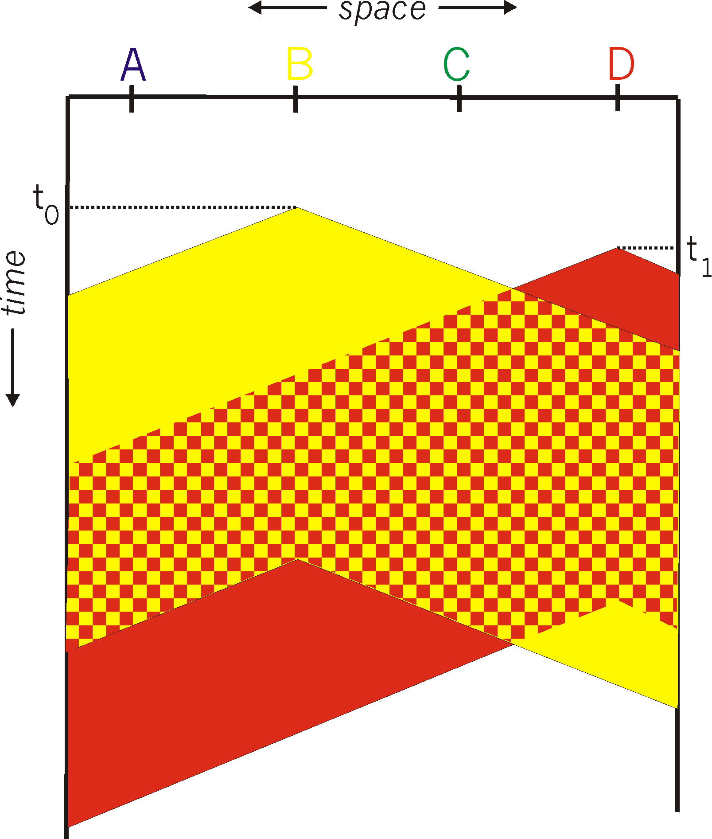
CSMA: collisions
spatial layout of nodes
collisions can still occur with carrier sensing:
propagation delay means two nodes may not hear each other’s just-started transmission
collision: entire packet transmission time wasted
distance & propagation delay play role in determining collision probability

Slide 13
CSMA: collisions
spatial layout of nodes
collisions can still occur with carrier sensing:
propagation delay means two nodes may not hear each other’s just-started transmission
collision: entire packet transmission time wasted
distance & propagation delay play role in determining collision probability

Slide 14
CSMA (carrier sense multiple access)
simple CSMA: listen before transmit:
if channel sensed idle: transmit entire frame
if channel sensed busy: defer transmission
human analogy: don’t interrupt others!
CSMA/CD: CSMA with collision detection
monitor for incoming signals while transmitting
if collision detected: stop sending and retry later
human analogy: If someone else starts talking at the same time, stop talking (the polite conversationalist).

Slide 15
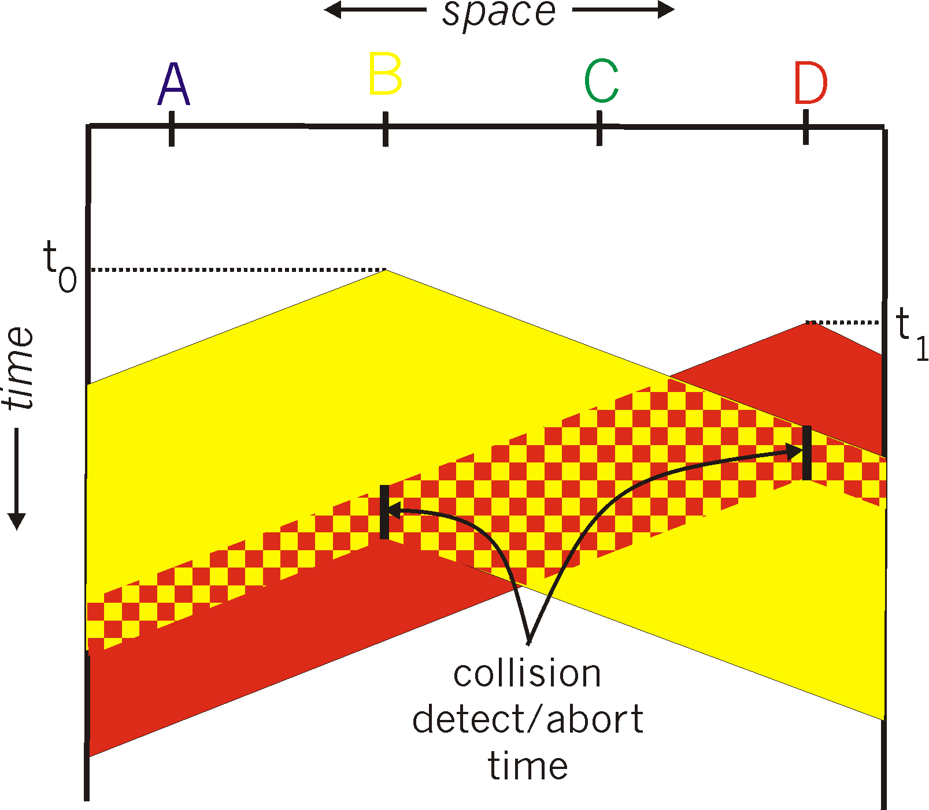
CSMA/CD:
spatial layout of nodes
CSMA/CD reduces the amount of time wasted in collisions
transmission aborted on collision detection

Slide 16
CSMA/CD:
spatial layout of nodes
CSMA/CD reduces the amount of time wasted in collisions
transmission aborted on collision detection
collisions detected within short time
colliding transmissions aborted, reducing channel wastage

Slide 17
Ethernet CSMA/CD algorithm
Ethernet receives datagram from network layer, creates frame
If Ethernet senses channel:
if idle: start frame transmission.
if busy: wait until channel idle, then transmit
If entire frame transmitted without collision - done!
If you detect collision, abort and wait a random amount of time (from a given range) and try again
If collision again, pick a random wait time from a larger range next time.
Notes:
For Ethernet, the actual amount of time a node waits is K # 512 bit times (i.e., K times the amount of time needed to send 512 bits into the Ethernet) and the maxi- mum value that n can take is capped at 10.

Slide 18
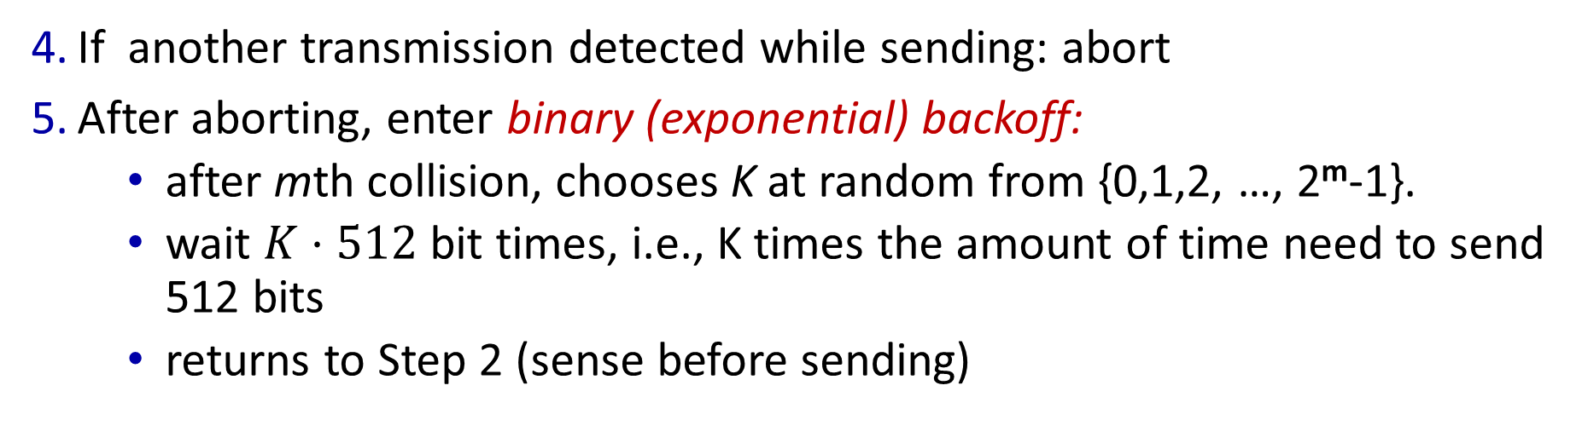
Ethernet CSMA/CD algorithm
If another transmission detected while sending: abort
After aborting, enter binary (exponential) backoff:
after mth collision, chooses K at random from {0,1,2, …, 2^{m}-1}.
wait $K⋅512$ bit times, i.e., K times the amount of time need to send 512 bits
returns to Step 2 (sense before sending)
Notes:
For Ethernet, the actual amount of time a node waits is K # 512 bit times (i.e., K times the amount of time needed to send 512 bits into the Ethernet) and the maxi- mum value that n can take is capped at 10.

Slide 19

Ethernet CSMA/CD algorithm
If another transmission detected while sending: abort
After aborting, enter binary (exponential) backoff:
after mth collision, chooses K at random from {0,1,2, …, 2^{m}-1}.
wait $K⋅512$ bit times, i.e., K times the amount of time need to send 512 bits
returns to Step 2 (sense before sending)
more collisions: longer backoff interval
Notes:
For Ethernet, the actual amount of time a node waits is K # 512 bit times (i.e., K times the amount of time needed to send 512 bits into the Ethernet) and the maxi- mum value that n can take is capped at 10.

Slide 20
Minimum frame size
Propagation delay = d
A
B
Suppose A sends a frame at time t
B sees an idle channel right before t + d and starts transmitting a frame
A won’t see a collision until t + 2d
Slides adapted from Jennifer Rexford, Princeton

Slide 21
Minimum frame size
Propagation delay = d
A
B
A should wait for time 2d to detect collision
So, it will keep transmitting during this period
That’s why there are restrictions on “classical” Ethernet
Maximum length of the wire: 2500 meters
Minimum length of the frame: 512 bits (64 bytes)
Slides adapted from Jennifer Rexford, Princeton

Slide 22
Link characteristics affect protocol design
In wired LANs, any two nodes on the shared medium can detect collision easily
measure signal strengths, and compare the transmitted and received signals
Ethernet uses CSMA/CD
But, in wireless LANs, collision detection is difficult
due to characteristics of wireless links
wireless LANs (WiFi) uses CSMA/CA: CSMA with collision avoidance
Notes:
For Ethernet, the actual amount of time a node waits is K # 512 bit times (i.e., K times the amount of time needed to send 512 bits into the Ethernet) and the maxi- mum value that n can take is capped at 10.

Slide 23



IEEE 802.11 (WiFi) MAC Protocol: CSMA/CA
Base stations (or Access point):
Connects end points via a wireless “link”
Shared physical medium
Connect to the wired network
E.g., the Internet
Provide connection from user devices to the wired network

Slide 24
Wireless link characteristics
fading (attenuation)
radio signal attenuates (loses power) as it propagates (free space “path loss”)
noise
received signal is a combination of attenuated original signal and background noise in the environment -> more “lossy” than wired link
SNR: signal-to-noise ratio
larger SNR -> lower bit error rate (BER) -- easier to extract signal from noise (a “good thing”)
Notes:
Wikipedia figure

Slide 25


Wireless link characteristics
Hidden terminal problem
B, A hear each other
B, C hear each other
A, C can not hear each other means A, C unaware of their interference at B
Attenuation also causes “hidden terminals”
B, A hear each other
B, C hear each other
A, C can not hear each other interfering at B
C
A
B
C
B
A
C’s signal
strength
A’s signal
strength
space

Slide 26
Wireless vs. Wired for multi-access channel
CSMA/CD tells whether or not there is some activity on the transmitter
In a wired setting, the transmitted can see all the activity on the channel. So, this is enough.
In a wireless setting, the transmitter does not necessary see all the activity on the channel.
We need some extra mechanisms!

Slide 27
WiFi CSMA/CA protocol
802.11 sender
1 if sense channel idle for DIFS then
transmit entire frame (no CD)
sender
receiver
DIFS
2 if sense channel busy then
start random backoff time
timer counts down while channel idle
transmit when timer expires
if no ACK, increase random backoff interval, repeat 2
data
SIFS
802.11 receiver
if frame received OK
return ACK after SIFS (ACK needed due to hidden terminal problem)
ACK

Slide 28
WiFi CSMA/CA protocol
802.11 sender
1 if sense channel idle for DIFS then
transmit entire frame (no CD)
Note the differences from CSMA/CD
sender
receiver
DIFS
2 if sense channel busy then
start random backoff time
timer counts down while channel idle
transmit when timer expires
if no ACK, increase random backoff interval, repeat 2
data
SIFS
802.11 receiver
if frame received OK
return ACK after SIFS (ACK needed due to hidden terminal problem)
ACK

Slide 29
WiFi CSMA/CA protocol
Reliable delivery mechanisms in the link layer!
802.11 sender
1 if sense channel idle for DIFS then
transmit entire frame (no CD)
Note the differences from CSMA/CD
sender
receiver
DIFS
2 if sense channel busy then
start random backoff time
timer counts down while channel idle
transmit when timer expires
if no ACK, increase random backoff interval, repeat 2
data
SIFS
802.11 receiver
if frame received OK
return ACK after SIFS (ACK needed due to hidden terminal problem)
ACK

Slide 30
WiFi CSMA/CA protocol
The protocol has optional extensions to reduce collisions even more…
802.11 sender
1 if sense channel idle for DIFS then
transmit entire frame (no CD)
Note the differences from CSMA/CD
sender
receiver
DIFS
2 if sense channel busy then
start random backoff time
timer counts down while channel idle
transmit when timer expires
if no ACK, increase random backoff interval, repeat 2
data
SIFS
802.11 receiver
if frame received OK
return ACK after SIFS (ACK needed due to hidden terminal problem)
ACK

Slide 31
Wireless links affect higher-layer protocols
In wireless LAN, bit errors are much more common than in wired networks. Packets may often be corrupted or lost for reasons other than congestion
but TCP will interpret any packet loss as congestion and reduce its send window
Solutions?
Have the “wireless” link layer protocol do retransmissions
Provide extra signals to TCP to convey if a loss is due to the nature of the wireless link rather than congestion
…

Slide 32
Link layer: roadmap
Link layer overview
Local Area Networks (LANs)
Switched LANs
Ethernet and Addressing
Address Resolution Protocol (ARP)
Switches
Virtual LANs (VLANs)
Shared LANs and multiple access protocols
Random access

Slide 33
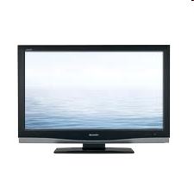



Cable access network: channel partitioning and random access!
Internet frames, TV channels, control transmitted
downstream at different frequencies
cable headend
…
CMTS
…
splitter
cable
modem
ISP
cable modem
termination system
multiple downstream (broadcast) channels (frequency-partitioned): up to 1.6 Gbps/channel
single CMTS transmits into channels
multiple upstream channels (up to 1 Gbps/channel)
multiple access: all users contend (random access) for certain upstream channel time slots; others assigned (time-partitioned) channels

Slide 34
What you need to know about multiple access channels
Know what a multiple access (or shared, or broadcast) channel is.
Know the details of CSMA/CD
E.g., if you are given a scenario with transmissions and how long nodes will back-off after detecting collision, you should be able to follow the protocol to figure out when collisions happen and when a frame will finally be transmitted.
Know the characteristics of wireless links and how they affect protocols designs
How does CSMA/CA work?
How is TCP affected?

Slide 35
Link layer: roadmap
Link layer overview
Local Area Networks (LANs)
Switched LANs
Ethernet and Addressing
Address Resolution Protocol (ARP)
Switches
Virtual LANs (VLANs)
Shared LANs and multiple access protocols
Random access

Slide 36
Final Remarks on MAC address vs IP addresses
Q: Why use a separate set of addresses in the link layer?
A: ??
32-bit IP address:
network-layer address for interface
used for layer 3 (network layer) forwarding
e.g.: 128.119.40.136
MAC (or LAN or physical or Ethernet) address:
function: used “locally” to get frame from one interface to another physically-adjacent interface (same subnet, in IP-addressing sense)
48-bit MAC address (for most LANs) burned in the ROM of the interface hardware, also sometimes software settable
e.g.: 1A-2F-BB-76-09-AD
hexadecimal (base 16) notation
(each “numeral” represents 4 bits)

Slide 37
What use a separate address space in the link layer?
Network layer and link layer have different goals, hence different requirements
Network layer: global connectivity
Need to aggregate addresses for interfaces close to each other to scale
So, IP addresses change when a device moves
Link layer: local connectivity
Much smaller scale -- It is ok to have fixed “random” address for the interface
A fixed address makes it easier to bootstrap (we can still talk with the interface until it gets its IP address, more on this next week!)
Also, each local network can have its own way to forward traffic
And still be able to connect to different kinds of networks…
through IP, or any other network layer protocol that they all agree on.
Any other thoughts?

Slide 38
Link layer: roadmap
Link layer overview
Local Area Networks (LANs)
Switched LANs
Ethernet and Addressing
Address Resolution Protocol (ARP)
Switches
Virtual LANs (VLANs)
Multiple access protocols
Random access
We are done with the link layer!
Next Up: Naming and Addressing

