Slide 1

CS 456/656
Computer Networks
Lecture 14: Link Layer – Part 1
Mina Tahmasbi Arashloo and Uzma Maroof
Fall 2025

Slide 2

A note on the slides
Adapted from the slides that accompany this book.
All material copyright 1996-2023
J.F Kurose and K.W. Ross, All Rights Reserved
Computer Networking: A Top-Down Approach
8th edition
Jim Kurose, Keith Ross
Pearson, 2020

Slide 3
Link layer: roadmap
Link layer overview
  Local Area Networks (LANs)
Switched LANs
Virtual LANs (VLANs)
Shared LANs and multiple access protocols

Slide 4
Link layer: roadmap
Link layer overview
  Local Area Networks (LANs)
Switched LANs
Virtual LANs (VLANs)
Shared LANs and multiple access protocols

Slide 5

Recall the question: How are interfaces (without intervening router) connected?
subnet 223.1.1.0/24
subnet 223.1.2.0/24
223.1.1.1
223.1.2.1
223.1.1.2
223.1.1.4
223.1.2.9
223.1.1.3
223.1.3.27
223.1.2.2
subnet
223.1.3.0/24
223.1.3.1
223.1.3.2

Slide 6

Network layer: global connectivity
Network layer provides connectivity across networks
A
B

Slide 7
Network layer: global connectivity
Network layer provides connectivity across networks
Its routing protocols find a series of routers from a source to a destination
A
B
Network layer doesn’t concern itself with what happens here

Slide 8
Link layer: local connectivity
Provides connectivity between (groups of) physically “adjacent” entities.
A
B

Slide 9
Link layer: local connectivity
Provides connectivity between (groups of) physically “adjacent” entities.
A
B

Slide 10
Link layer: local connectivity
Provides connectivity between (groups of) physically “adjacent” entities.
A
B

Slide 11
Link layer: local connectivity
Provides connectivity between (groups of) physically “adjacent” entities.
A
B

Slide 12
Link layer: local connectivity
Also called a Local Area Network (LAN)
Either “shared link” or a link-layer network

Slide 13

Shared LAN via shared link
shared wire
(e.g., cabled Ethernet)
shared radio
(4G/5G, Wi-Fi, satellite)
humans at a gathering
(shared air, acoustical)

Slide 14
Switched LAN via link-layer network
Will start with the “switched” LANs first and circle back to “shared links” afterwards.
L2 switch
L2 = Layer 2, aka link layer

Slide 15
Link layer: roadmap
Link layer overview
  Local Area Networks (LANs)
Switched LANs
  Ethernet and Addressing
  Address Resolution Protocol (ARP)
  Switches
Virtual LANs (VLANs)
Shared LANs and multiple access protocols

Slide 16
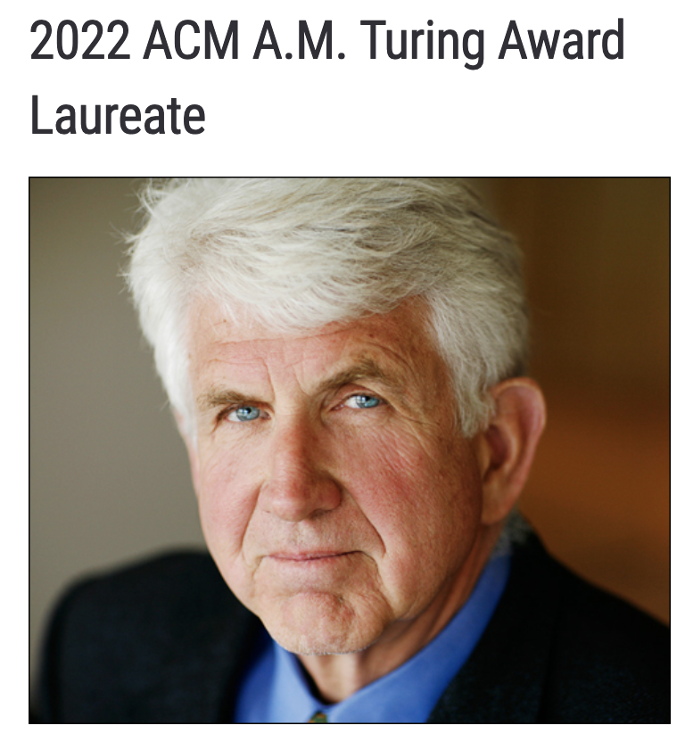
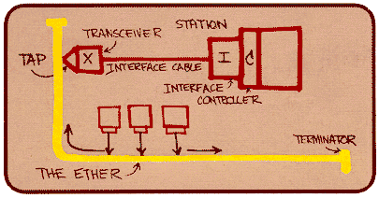
Ethernet
“dominant” wired LAN technology:
first widely used LAN technology
kept up with speed race: 10 Mbps – 400 Gbps
Bob Metcalfe: Ethernet co-designer,
2022 ACM Turing Award recipient
Metcalfe’s Ethernet sketch
https://www.uspto.gov/learning-and-resources/journeys-innovation/audio-stories/defying-doubters

Slide 17
Ethernet: physical topology
bus: popular through mid 90s
  all nodes in same collision domain (can collide with each other)
  “shared link”: will talk about it later.
switched: prevails today
  active link-layer switch in center
  each “spoke” runs a (separate) Ethernet protocol (nodes do not collide with each other)
bus: coaxial cable
switched

Slide 18
Ethernet: unreliable, connectionless
connectionless: no handshaking between sending and receiving interfaces
unreliable: receiving interface doesn’t send ACKs to sending interface
  data in dropped frames recovered only if initial sender uses higher layer rdt (e.g., TCP), otherwise dropped data lost

Slide 19
Ethernet frame structure
sending interface encapsulates IP datagram (or other network layer protocol packet) in Ethernet frame
type
preamble
dest.
address
source
address
data (payload)
CRC
preamble:
used to synchronize receiver, sender clock rates
7 bytes of 10101010 followed by one byte of 10101011

Slide 20
Ethernet frame structure (more)
type
preamble
dest.
address
source
address
data (payload)
CRC
addresses: 6-byte source, destination MAC addresses
  if interface receives frame with matching destination address, or with broadcast address, it passes data in frame to network layer protocol
  otherwise, interface discards frame.
type: indicates higher layer protocol
  mostly IP but others possible, e.g., Novell IPX, AppleTalk
  used to demultiplex up at receiver
CRC: cyclic redundancy check at receiving interface
  error detected: frame is dropped

Slide 21
MAC addresses
32-bit IP address:
  network-layer address for interface
  used for layer 3 (network layer) forwarding
  e.g.: 128.119.40.136
MAC (or LAN or physical or Ethernet) address:
  function: used “locally” to get frame from one interface to another physically-adjacent interface (same subnet, in IP-addressing sense)
  48-bit MAC address (for most LANs) burned in the ROM of the interface hardware, also sometimes software settable
  e.g.: 1A-2F-BB-76-09-AD
hexadecimal (base 16) notation
(each “numeral” represents 4 bits)

Slide 22
MAC addresses
Q: Why use a separate set of addresses in the link layer?
A: We will come back to this towards the end of the course.
32-bit IP address:
  network-layer address for interface
  used for layer 3 (network layer) forwarding
  e.g.: 128.119.40.136
MAC (or LAN or physical or Ethernet) address:
  function: used “locally” to get frame from one interface to another physically-adjacent interface (same subnet, in IP-addressing sense)
  48-bit MAC address (for most LANs) burned in the ROM of the interface hardware, also sometimes software settable
  e.g.: 1A-2F-BB-76-09-AD
hexadecimal (base 16) notation
(each “numeral” represents 4 bits)

Slide 23
MAC addresses
each interface on LAN
has unique 48-bit MAC address
has a locally unique 32-bit IP address (as we’ve seen)
137.196.7.78
1A-2F-BB-76-09-AD
LAN
137.196.7/24
71-65-F7-2B-08-53
58-23-D7-FA-20-B0
137.196.7.23
137.196.7.14
0C-C4-11-6F-E3-98
137.196.7.88

Slide 24
Routing to another subnet: addressing
walkthrough: sending a datagram from A to B via R
  focus on addressing – at IP (datagram) and MAC layer (frame) levels
  assume that:
    A knows B’s IP address
    A knows IP address of first hop router, R
    A knows R’s MAC address
A
R
B
111.111.111.111
74-29-9C-E8-FF-55
222.222.222.222
49-BD-D2-C7-56-2A
222.222.222.220
1A-23-F9-CD-06-9B
111.111.111.112
111.111.111.110
CC-49-DE-D0-AB-7D
E6-E9-00-17-BB-4B
222.222.222.221
88-B2-2F-54-1A-0F

Slide 25
Routing to another subnet: addressing
A creates IP datagram with IP source A, destination B
A creates link-layer frame containing A-to-B IP datagram
  R's MAC address is frame’s destination
MAC src: 74-29-9C-E8-FF-55
MAC dest: E6-E9-00-17-BB-4B
IP
Eth
Phy
IP src: 111.111.111.111
IP dest: 222.222.222.222
A
R
B
111.111.111.111
74-29-9C-E8-FF-55
222.222.222.222
49-BD-D2-C7-56-2A
222.222.222.220
1A-23-F9-CD-06-9B
111.111.111.112
111.111.111.110
CC-49-DE-D0-AB-7D
E6-E9-00-17-BB-4B
222.222.222.221
88-B2-2F-54-1A-0F

Slide 26
Routing to another subnet: addressing
frame sent from A to R
frame received at R, datagram removed, passed up to IP
MAC src: 74-29-9C-E8-FF-55
MAC dest: E6-E9-00-17-BB-4B
IP src: 111.111.111.111
IP dest: 222.222.222.222
IP
Eth
Phy
IP src: 111.111.111.111
IP dest: 222.222.222.222
IP
Eth
Phy
A
R
B
111.111.111.111
74-29-9C-E8-FF-55
222.222.222.222
49-BD-D2-C7-56-2A
222.222.222.220
1A-23-F9-CD-06-9B
111.111.111.112
111.111.111.110
CC-49-DE-D0-AB-7D
E6-E9-00-17-BB-4B
222.222.222.221
88-B2-2F-54-1A-0F

Slide 27
Routing to another subnet: addressing
R determines outgoing interface, passes datagram with IP source A, destination B to link layer
R creates link-layer frame containing A-to-B IP datagram. Frame destination address: B's MAC address
MAC src: 1A-23-F9-CD-06-9B
MAC dest: 49-BD-D2-C7-56-2A
IP
Eth
Phy
IP src: 111.111.111.111
IP dest: 222.222.222.222
A
R
B
111.111.111.111
74-29-9C-E8-FF-55
222.222.222.222
49-BD-D2-C7-56-2A
222.222.222.220
1A-23-F9-CD-06-9B
111.111.111.112
111.111.111.110
CC-49-DE-D0-AB-7D
E6-E9-00-17-BB-4B
222.222.222.221
88-B2-2F-54-1A-0F

Slide 28
Routing to another subnet: addressing
R determines outgoing interface, passes datagram with IP source A, destination B to link layer
R creates link-layer frame containing A-to-B IP datagram. Frame destination address: B's MAC address
MAC src: 1A-23-F9-CD-06-9B
MAC dest: 49-BD-D2-C7-56-2A
transmits link-layer frame
IP
Eth
Phy
IP
Eth
Phy
IP src: 111.111.111.111
IP dest: 222.222.222.222
A
R
B
111.111.111.111
74-29-9C-E8-FF-55
222.222.222.222
49-BD-D2-C7-56-2A
222.222.222.220
1A-23-F9-CD-06-9B
111.111.111.112
111.111.111.110
CC-49-DE-D0-AB-7D
E6-E9-00-17-BB-4B
222.222.222.221
88-B2-2F-54-1A-0F

Slide 29
Routing to another subnet: addressing
B receives frame, extracts IP datagram destination B
B passes datagram up protocol stack to IP
IP src: 111.111.111.111
IP dest: 222.222.222.222
IP
Eth
Phy
IP
Eth
Phy
A
R
B
111.111.111.111
74-29-9C-E8-FF-55
222.222.222.222
49-BD-D2-C7-56-2A
222.222.222.220
1A-23-F9-CD-06-9B
111.111.111.112
111.111.111.110
CC-49-DE-D0-AB-7D
E6-E9-00-17-BB-4B
222.222.222.221
88-B2-2F-54-1A-0F

Slide 30
Make sure you know
The division of labor between the network layer and the link layer
  Global connectivity vs local connectivity
What a MAC address is and how it is represented
The important fields in the Ethernet header
  Source MAC address, destination MAC address, type

Slide 31
Make sure you know
How the network layer and the link layer work together to deliver packets end to end
  E.g., given a packet, its path through the network, and information about the relevant interfaces, you should be able to figure out source and destination IP and MAC addresses as the packet traverses the network.

Slide 32
link layer forwarding exercise
R2
B
IP_A, MAC_A
1
2
A
IP_B, MAC_B
2
1
1
3
2
3
R1
R3
IP_Ri_j = IP address of interface #j of Ri
MAC_Ri_j = MAC address of interface #j of Ri
Routing protocol picks least-cost paths. Link costs:
  <R1,R2>: 1, <R2,R3>: 2, <R1, R3>: 5
What are the source and destination IP and MAC address of a packet at each hop going from A to B?

Slide 33
Answer
The least cost path from A to B is A -> R1 -> R2 -> R3 -> B
The source and destination IP address do not change throughout.
The source and destination MAC addresses depend on the sending interface and receiving interface in each segment of the path.

Slide 34
Answer
A -> R1:
  Source IP: IP_A
  Dest IP: IP_B
  Source MAC: MAC_A
  Dest MAC: MAC_R1_1
R1 -> R2:
  Source IP: IP_A
  Dest IP: IP_B
  Source MAC: MAC_R1_2
  Dest MAC: MAC_R2_1
R2 -> R3:
  Source IP: IP_A
  Dest IP: IP_B
  Source MAC: MAC_R2_2
  Dest MAC: MAC_R3_1
R3 -> B:
  Source IP: IP_A
  Dest IP: IP_B
  Source MAC: MAC_R3_3
  Dest MAC: MAC_B

Slide 35
Link layer: roadmap
Link layer overview
  Local Area Networks (LANs)
Switched LANs
  Ethernet and Addressing
  Address Resolution Protocol (ARP)
  Switches
Virtual LANs (VLANs)
Shared LANs and multiple access protocols

Slide 36
ARP: address resolution protocol
Question: how to determine interface’s MAC address, knowing its IP address?
ARP table: each IP node (host, router) on LAN has table
ARP
137.196.7.78
  IP/MAC address mappings for some LAN nodes:
< IP address; MAC address; TTL>
  TTL (Time To Live): time after which address mapping will be forgotten (typically 20 min)
1A-2F-BB-76-09-AD
ARP
ARP
LAN
71-65-F7-2B-08-53
58-23-D7-FA-20-B0
137.196.7.23
137.196.7.14
ARP
0C-C4-11-6F-E3-98
137.196.7.88

Slide 37
ARP protocol in action
example: A wants to send datagram to B
  B’s MAC address not in A’s ARP table, so A uses ARP to find B’s MAC address
A broadcasts ARP query, containing B's IP addr
  destination MAC address = FF-FF-FF-FF-FF-FF
  all nodes on LAN receive ARP query
1
Ethernet frame (sent to FF-FF-FF-FF-FF-FF)
C
Source MAC: 71-65-F7-2B-08-53
Source IP: 137.196.7.23
Target IP address: 137.196.7.14
…
ARP table in A
IP addr
MAC addr
TTL
TTL
A
B
1
71-65-F7-2B-08-53
58-23-D7-FA-20-B0
137.196.7.23
137.196.7.14
ARP operates directly over Ethernet. In an ARP query, the first header is Ethernet, and then ARP.
D

Slide 38
ARP protocol in action
example: A wants to send datagram to B
  B’s MAC address not in A’s ARP table, so A uses ARP to find B’s MAC address
ARP message into Ethernet frame (sent to 71-65-F7-2B-08-53)
C
Target IP address: 137.196.7.14
Target MAC address:
58-23-D7-FA-20-B0
…
ARP table in A
IP addr
MAC addr
TTL
TTL
A
B
2
71-65-F7-2B-08-53
58-23-D7-FA-20-B0
137.196.7.23
137.196.7.14
2
B replies to A with ARP response, giving its MAC address
D

Slide 39
ARP protocol in action
example: A wants to send datagram to B
  B’s MAC address not in A’s ARP table, so A uses ARP to find B’s MAC address
C
ARP table in A
IP addr
MAC addr
TTL
TTL
A
B
137.196.
7.14
58-23-D7-FA-20-B0
500
71-65-F7-2B-08-53
58-23-D7-FA-20-B0
137.196.7.23
137.196.7.14
3
A receives B’s reply, adds B entry into its local ARP table
D

Slide 40
Make sure you know
That ARP operates directly over Ethernet
How ARP helps end hosts determine the MAC address associated with an IP address.
  The steps involved address resolution
  What the source and destination MAC addresses in ARP queries and responses are
  What is included in ARP queries and responses.

Slide 41
Link layer: roadmap
Link layer overview
  Local Area Networks (LANs)
Switched LANs
  Ethernet and Addressing
  Address Resolution Protocol (ARP)
  Switches
Virtual LANs (VLANs)
Shared LANs and multiple access protocols

Slide 42
Link layer: a link-layer network
L2 switch
L2 = Layer 2, aka link layer

Slide 43
Ethernet switch
A link-layer switch
  store, forward Ethernet (or other type of) frames
  examine incoming frame’s MAC address, selectively forward frame to one-or-more outgoing links
transparent: hosts unaware of presence of switches
plug-and-play, self-learning
  switches do not need to be configured

Slide 44
Ethernet Switch
hosts have dedicated, direct connection to switch
switches buffer packets
Ethernet protocol used on each incoming link, so:
  No shared medium, no collisions
  each link is its own collision domain
A
C’
B
1
2
6
3
5
4
B’
C
A’
switch with six interfaces (1,2,3,4,5,6)

Slide 45

Ethernet Switch
hosts have dedicated, direct connection to switch
switches buffer packets
Ethernet protocol used on each incoming link, so:
  No shared medium, no collisions
  each link is its own collision domain
A
C’
B
1
2
6
3
5
4
B’
C
A’
switch with six interfaces (1,2,3,4,5,6)

Slide 46
Switch forwarding table
Q: how does switch know A’ reachable via interface 4, B’ reachable via interface 5?
A
C’
B
A: each switch has a switch table, each entry:
  (MAC address of host, interface to reach host, time stamp)
  looks like a routing table!
1
2
6
3
5
4
B’
C
A’
Q: how are entries created, maintained in switch table?
  something like a routing protocol?

Slide 47
Switch: self-learning
Source: A
switch learns which hosts can be reached through which interfaces
Dest: A’
A A’
A
C’
B
  when frame received, switch “learns” location of sender: incoming LAN segment
1
2
6
3
5
4
  records sender/location pair in switch table
B’
C
A’
Switch table
(initially empty)
MAC addr interface TTL
A
1
60

Slide 48
Switch: frame filtering/forwarding
when frame received at switch:
  1. record incoming link, MAC address of sending host
  2. Check there is an entry for the MAC destination address in the switch table
  3. if entry found for destination
  then {
  if destination connected to the interface from which frame arrived
  then drop frame
  else forward frame on interface indicated by entry
  }
  else flood /* forward on all interfaces except arriving interface */

Slide 49
Self-learning, forwarding: example
Source: A
Dest: A’
frame destination, A’, location unknown:
A A’
flood
A
C’
B
destination A location known:
selectively send
on just one link
1
2
6
A A’
A A’
A A’
A A’
A A’
3
5
4
B’
C
A’ A
A’
MAC addr interface TTL
A
1
60
switch table
(initially empty)
A’
4
60

Slide 50
Switch: frame filtering/forwarding
when frame received at switch:
  1. record incoming link, MAC address of sending host
  2. Check there is an entry for the MAC destination address in the switch table
  3. if entry found for destination
  then {
  if destination connected to the interface from which frame arrived
  then drop frame
  else forward frame on interface indicated by entry
  }
  else flood /* forward on all interfaces except arriving interface */
Why?

Slide 51


Interconnecting switches
self-learning switches can be connected together:
S₄
S₁
S₃
A
S₂
F
I
B
C
D
E
G
H
Q: sending from A to G - how does S₁ know to forward frame destined to G via S₄ and S₃?
A: self learning! (works exactly the same as in single-switch case!)

Slide 52
Self-learning multi-switch exercise
1
S₄
2
3
S₁
4
1
S₃
1
1
A
S₂
4
2
2
4
F
2
3
D
3
3
I
B
C
E
G
H
MAC_X is the MAC address of end host X
Suppose C sends frame to I, I responds to C.
show updates to switch tables as packets are forwarded in S₁, S₂, S₃, S₄

Slide 53
Answer
C sends a frame with source MAC address MAC_C and dest MAC address MAC_I.
S1 updates its switch table to record <MAC_C, 3, ttl>
S1 sends copies of the frame on ports 1, 2, 4
S4 receives the frame, updates it switch table to record <MAC_C, 1, ttl>
S4 sends copies of the frame on ports 2 and 3
S2 receives the frame, updates it table to record <MAC_C, 1, ttl>
S2 sends copies of the frame on ports 2, 3, 4.

Slide 54
Answer
S3 receives the frame, updates its table to record <MAC_C, 1, ttl>
S3 forwards copies of the frame on ports 1, 2, 4
I receives the frame, responds with a frame with source MAC address MAC_I and dest MAC address MAC_C
S3 updates its table to record <MAC_I, 4, ttl>
S3 forwards the frame on port 1
S4 updates its table to record <MAC_I, 3, ttl>
S4 forwards the frame on port 1

Slide 55
Answer
S1 updates its table to record <MAC_I, 4, ttl>
S1 forwards the frame on port 3

Slide 56
L2 Switches vs. routers
application
transport
network
link
physical
both are store-and-forward:
routers: network-layer devices (examine network-layer headers)
L2 switches: link-layer devices (examine link-layer headers)
datagram
frame
link
physical
frame
L2 switch
network
link
physical
datagram
both have forwarding tables:
routers: compute tables using routing algorithms, IP addresses
L2 switches: learn forwarding table using flooding, learning, MAC addresses
frame
application
transport
network
link
physical
6-56

Slide 57
Make sure you know
What Ethernet switches are
How they forward data between the interfaces of a LAN
  When there is only a single L2 switch
  Or when there is a network L2 switches
Specifically, make sure you know how the switch forwards packets
  The switch table
And how it learns mappings between MAC addresses and interfaces to reach them.

