Slide 1

CS 456/656 Computer Networks
Lecture 11: Network Layer – Part 3
Mina Tahmasbi Arashloo and Uzma Maroof
Fall 2025

Slide 2

A note on the slides
Adapted from the slides that accompany this book.
All material copyright 1996-2023
J.F Kurose and K.W. Ross, All Rights Reserved
Computer Networking: A Top-Down Approach 8th edition Jim Kurose, Keith Ross Pearson, 2020

Slide 3
Network layer: roadmap
Network layer overview
Routing algorithms
Network layer in the Internet

Slide 4
Network Layer in the Internet
host, router network layer functions:
transport layer: TCP, UDP
IP protocol
datagram format
addressing
packet handling conventions
Path-selection algorithms: implemented in
routing protocols (OSPF, BGP)
SDN controller
network
layer
forwarding
table
ICMP protocol
error reporting
router “signaling”
link layer
physical layer
Notes:
IP is not aboutbrouting, its about addressing, and how packets are fragmented and reassembled

Slide 5
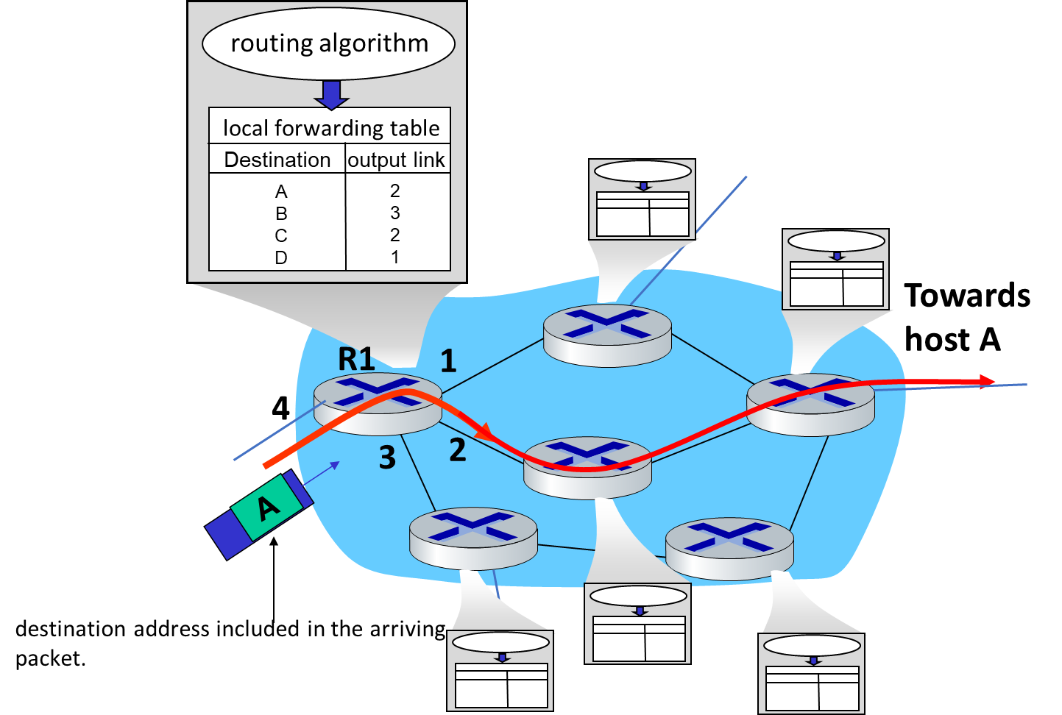
Network Layer in the Internet
Suppose you want to connect billions of end points together!
How does this affect addressing, routing, and forwarding in the network layer?

Slide 6
Network Layer in the Internet
Suppose you want to connect billions of end points together!
How does this affect addressing, routing, and forwarding in the network layer?
Forwarding tables would have to have billions of entries, one for each address
Routing algorithms would have to find a path for each individual address
Routing algorithms would have to run across millions of routers
…

Slide 7
Network Layer in the Internet
A “flat” network will not scale!
Internet and its best-effort network layer are designed with hierarchy in mind
Addresses are hierarchical – hosts that are “close” together have addresses that can be combined into one “group identifier”
Routing is hierarchical – routers learn how to reach groups of addresses.
Forwarding is hierarchical – forwarding tables keep entries about paths to groups of addresses.

Slide 8
Network Layer in the Internet
IP: Internet’s best effort network-layer protocol.
We’ll discuss:
What IP datagrams look like
What IP addresses look like
How the network finds paths for datagrams going from one IP address to another (i.e., routing algorithms)
How routers forward packets
…

Slide 9
Network Layer in the Internet
The Internet Protocol (IP)
Datagram format
Addressing
Network address translation
IPv6
Internet Routing
Internet Forwarding

Slide 10
Network Layer in the Internet
The Internet Protocol (IP)
Datagram format
Addressing
Network address translation
IPv6
Internet Routing
Internet Forwarding

Slide 11
IP Standard
IPv4 first and widely deployed Internet protocol
many problems in today’s Internet
IPv6 replacement
long (long!) time for deployment and use
25 years and counting!
think of the much faster application-level changes in last 25 years: WWW, social media, streaming media, gaming, telepresence, …
Why? We’ll come back to this later in the lecture

Slide 12
IPv4 Datagram format
32 bits
IP protocol version number
head.
len
type of
service
total datagram
length (bytes)
ver
length
header length(bytes)
“type” of service:
diffserv (0:5)
ECN (6:7)
flgs
fragment
offset
fragmentation/
reassembly
16-bit identifier
time to
live
upper
layer
header
checksum
header checksum
TTL: remaining max hops
(decremented at each router)
source IP address
32-bit source IP address
destination IP address
Maximum length: 64K bytes
Typically: 1500 bytes or less
upper layer protocol (e.g., TCP or UDP)
32-bit destination IP address
overhead
options (if any)
e.g., timestamp, record route taken
20 bytes of TCP
20 bytes of IP
= 40 bytes + app layer overhead for TCP+IP
payload data
(variable length,
typically a TCP
or UDP segment)
Notes:
Version tells how to interpret the following header. Why need header length? Coz it has options. Typically its 20 bytes,
TOS for example different service for real-time traffic. Service is configured by network admin.
Frag: large datagram is broken into multiple. Ipv^ does not allow it.
TTL not to circulate forever. Decremented at each router. When zero? Router must discard it.
Protocol: only used at destination. Mux b/w network and trans.
Cheksum: Router Computes checksum for each incoming packet. Why? TTL and options may change.
Why checksum if TCP already computes it? Can have IP w/o TCP and TCP w/o IP.
Options were designed to be used rarely, but mere existence creates complication? Cannot determine apriori where the data starts, can slow down routers. ➔ omitted from IPv6

Slide 13
Network Layer in the Internet
The Internet Protocol (IP)
Datagram format
Addressing
Network address translation
IPv6
Internet Routing
Internet Forwarding

Slide 14

IP addressing: introduction
223.1.1.1
IP address: 32-bit identifier associated with each host or router interface
interface: connection between host/router and physical link
router’s typically have multiple interfaces
host typically has one or two interfaces (e.g., wired Ethernet, wireless 802.11)
223.1.2.1
223.1.1.2
223.1.1.4
223.1.2.9
223.1.1.3
223.1.3.27
223.1.2.2
223.1.3.1
223.1.3.2
dotted-decimal IP address notation:
223.1.1.1 = 11011111 00000001 00000001 00000001
223
1
1
1
Notes:
Each interface on every host and router in the global Internet must have an IP address that is globally unique
What can you notice in this figure?
Whats common and uncommon in these addresses?

Slide 15

IP addressing: introduction
223.1.1.1
Q: how are interfaces (without an intervening router) actually connected?
223.1.2.1
223.1.1.2
A: wired
Ethernet interfaces connected by Ethernet switches
223.1.1.4
223.1.2.9
A: we’ll learn about that later
223.1.1.3
223.1.3.27
223.1.2.2
223.1.3.1
223.1.3.2
For now: don’t need to worry about how two interfaces without an intervening router are connected
A: wireless WiFi interfaces connected by WiFi base station

Slide 16
IP addressing: properties
Global uniqueness:
identifies hosts
Hierarchical structure:
consists of Subnet part + Host part
is necessary for Internet to scale to large number of hosts
aids Internet routing

Slide 17
Subnets
223.1.1.1
What’s a subnet ?
device interfaces that can physically reach each other without passing through an intervening router
223.1.2.1
223.1.1.2
223.1.1.4
223.1.2.9
223.1.1.3
223.1.3.27
223.1.2.2
IP addresses have structure:
subnet part (or prefix): devices in same subnet have common high order bits
host part: remaining low order bits
223.1.3.1
223.1.3.2
network consisting of 3 subnets
Notes:
IP addressing assigns an address to this subnet: 223.1.1.0/24, where the /24 (“slash-24”) notation, sometimes known as a subnet mask, indicates that the leftmost 24 bits of the 32-bit quantity define the subnet address. The 223.1.1.0/24 subnet thus consists of the three host interfaces (223.1.1.1, 223.1.1.2, and 223.1.1.3) and one router interface (223.1.1.4). Any additional hosts attached to the 223.1.1.0/24 subnet would be required to have an address of the form 223.1.1.xxx.

Slide 18
Subnets
subnet 223.1.1.0/24
223.1.1.1
subnet 223.1.2.0/24
Recipe for defining subnets:
detach each interface from its host or router, creating “islands” of isolated networks
each isolated network is called a subnet
223.1.2.1
223.1.1.2
223.1.1.4
223.1.2.9
223.1.1.3
223.1.3.27
223.1.2.2
subnet
223.1.3.0/24
223.1.3.1
223.1.3.2
subnet mask: /24
(high-order 24 bits: subnet part of IP address)

Slide 19
Subnets
223.1.1.2
subnet 223.1.1/24
where are the subnets?
what are the /24 subnet addresses?
223.1.1.1
223.1.1.4
223.1.1.3
223.1.9.2
223.1.7.0
subnet 223.1.7/24
subnet 223.1.9/24
223.1.9.1
223.1.7.1
223.1.8.1
223.1.8.0
subnet 223.1.2/24
223.1.2.6
subnet 223.1.8/24
223.1.3.27
subnet 223.1.3/24
223.1.2.1
223.1.2.2
223.1.3.1
223.1.3.2

Slide 20
IP addressing: CIDR
CIDR: Classless InterDomain Routing (pronounced “cider”)
subnet portion of address of arbitrary length
address format: a.b.c.d/x, where x is # bits in subnet portion of address
subnet
part
host
part
11001000 00010111 00010000 00000000
200.23.16.0/23
Notes:
The Internet’s address assignment strategy.
The x most significant bits of an constitute the network portion of the IP address/(or network prefix) of the address. An organization is typically assigned a block of contiguous addresses, that is, a range of addresses
the IP addresses of devices within the organization will share the common prefix.
when a router outside the organization forwards a datagram whose destination address is inside the organization, only the leading x bits of the address need be considered.
This considerably reduces the size of the forwarding table in these routers, since a single entry of the form a.b.c.d/x will be sufficient to forward packets

Slide 21
IP addressing: CIDR
Q:What is the range of subnet 200.23.16.64/26?
6 free bits or 64 addresses
Last 8 bits are of the format 01XX XXXX
The range is 200.23.16.64 - 200.23.16.127
subnet
part
host
part
subnet
part
host
part
to
11001000 00010111 00010000 01000000
11001000 00010111 00010000 01111111
200.23.16.64
200.23.16.127

Slide 22
Subnet masks
We’ve seen subnet masks as /24, which is the number of bits in the subnet vs interfaces inside that subnet
Computers represent subnet masks using binary only, but not in the way you think!
What is subnet mask of 24?
11000?
No!!!
It would be:
1111 1111 . 1111 1111 . 1111 1111 . 0000 0000
This represents whether each bit is in the subnet or not!
OR 255.255.255.0 (in decimal)

Slide 23
Route Aggregation
routing algorithm
Recall:
Forwarding table maps destination addresses to outgoing link
As the number of possible IP (4 billion!) is huge, rows of forwarding table lists ranges of address, rather than individual hosts
local forwarding table
Destination
output link
A
B
C
D
2
3
2
1
Towards host A
R1
1
4
3
2
A
destination address included in the arriving packet.

Slide 24
Route Aggregation
routing algorithm
Recall:
Forwarding table maps destination addresses to outgoing link
As the number of possible IP (4 billion!) is huge, rows of forwarding table lists ranges of address, rather than individual hosts
local forwarding table
Destination
output link
Address range 1
Address range 2
Address range 3
Address range 4
2
3
2
1
Towards host A
R1
1
4
3
2
A
destination address included in the arriving packet.

Slide 25
Route Aggregation
Longest prefix matching
For a given destination address, determine the output link based on the entry with longest address prefix that matches the address
E.g., the destination address 200.23.16.1 falls into ranges of both the first and second rows in the forwarding table; it is forwarded to output link 2 based on longest prefix matching
local forwarding table
Destination
output link
11001000 00010111 00010000 00000000 / 23
2
200.23.16.0 / 23
11001000 00010111 00010000 00000000 / 20
3
200.23.16.0 / 20
11001000 00010111 00011000 00000000 / 23
2
200.23.24.0 / 23
Otherwise
1

Slide 26
IP addresses: how to get one?
That’s actually two questions:
Q: How does a host get IP address within its network (host part of address)?
Q: How does a network get IP address for itself (network part of address)
Notes:
32-x bits of an address can be thought of as distinguishing among the devices within the organization, all of which have the same network prefix. These are the bits that will be considered when forwarding packets at routers within the organization.

Slide 27
IP addresses: how to get one?
Q: how does network get subnet part of IP address?
A: gets allocated portion of its provider ISP’s address space
ISP's block 11001000 00010111 00010000 00000000 200.23.16.0/20
ISP can then allocate out its address space in 8 blocks:
Organization 0 11001000 00010111 00010000 00000000 200.23.16.0/23
Organization 1 11001000 00010111 00010010 00000000 200.23.18.0/23
Organization 2 11001000 00010111 00010100 00000000 200.23.20.0/23
... ….. …. ….
Organization 7 11001000 00010111 00011110 00000000 200.23.30.0/23

Slide 28
Hierarchical addressing
Q: how does network get subnet part of IP address?
A: gets allocated portion of its provider ISP’s address space
ISP's block 11001000 00010111 00010000 00000000 200.23.16.0/20
ISP can then allocate out its address space in 8 blocks:
Organization 0 11001000 00010111 00010000 00000000 200.23.16.0/23
Organization 1 11001000 00010111 00010010 00000000 200.23.18.0/23
Organization 2 11001000 00010111 00010100 00000000 200.23.20.0/23
... ….. …. ….
Organization 7 11001000 00010111 00011110 00000000 200.23.30.0/23

Slide 29
Route aggregation example
hierarchical addressing allows efficient advertisement of routing information:
Organization 0
200.23.16.0/23
Organization 1
200.23.18.0/23
“Send me anything
with addresses
beginning
200.23.16.0/20”
Organization 2
200.23.20.0/23
.
Fly-By-Night-ISP
.
.
.
.
Internet
Organization 7
.
200.23.30.0/23
ISPs-R-Us
“Send me anything
with addresses
beginning
199.31.0.0/16”
Notes:
ISP that connects eight organizations
Fly-By-Night-ISP advertises to the outside world that it should be sent any datagrams whose first 20 address bits match 200.23.16.0/20.
The rest of the world need not know that within the address block 200.23.16.0/20 there are in fact eight other organizations, each with its own subnets.
This ability to use a single prefix to advertise multiple networks is often referred to as address aggregation (also route aggregation or route summarization).
works extremely well when addresses are allocated in blocks to ISPs and then from ISPs to client organizations.
But what happens when addresses are not allocated in such a hierarchical manner?

Slide 30
Route aggregation example
Organization 1 moves from Fly-By-Night-ISP to ISPs-R-Us
ISPs-R-Us now advertises a more specific route to Organization 1
Organization 0
200.23.16.0/23
Organization 1
200.23.18.0/23
“Send me anything
with addresses
beginning
200.23.16.0/20”
Organization 2
200.23.20.0/23
.
Fly-By-Night-ISP
.
.
.
.
Internet
Organization 7
.
200.23.30.0/23
ISPs-R-Us
“Send me anything
with addresses
beginning
199.31.0.0/16”
Organization 1
200.23.18.0/23
“or 200.23.18.0/23”

Slide 31
Route aggregation example
Organization 1 moves from Fly-By-Night-ISP to ISPs-R-Us
ISPs-R-Us now advertises a more specific route to Organization 1
Organization 0
200.23.16.0/23
“Send me anything
with addresses
beginning
200.23.16.0/20”
Organization 2
200.23.20.0/23
.
Fly-By-Night-ISP
.
.
.
.
Internet
Organization 7
.
200.23.30.0/23
ISPs-R-Us
“Send me anything
with addresses
beginning
199.31.0.0/16”
Organization 1
200.23.18.0/23
“or 200.23.18.0/23”
Notes:
Organization 1 could renumber all of its routers and hosts to have addresses within the ISPs-R-Us address block. But this is a costly solution, and Organization 1 might well be reassigned to another subsidiary in the future.
routers will see two matches and will use longest prefix matching

Slide 32
In-Class Exercise
Q: A router connects 3 subnets. Each subnet must have prefix 200.23.16.0/24
Subnet 1 supports up to 123 interfaces
Subnet 2 and subnet 3 up to 60 interfaces
What should the 3 subnet addresses be?

Slide 33
In-Class Exercise
Q: A router connects 3 subnets. Each subnet must have prefix 200.23.16.0/24
Subnet 1 supports up to 123 interfaces
Subset 2 and subset 3 up to 60 interfaces
What should the 3 subnet addresses be?
Subnet 1 gets 200.23.16.0/25 (last 8-bit 0XXX XXXX)
Subnet 2 gets 200.23.16.128/26 (last 8-bit 10XX XXXX)
Subnet 3 gets 200.23.16.192/26 (last 8-bit 11XX XXXX)

Slide 34
Network Layer in the Internet
The Internet Protocol (IP)
Datagram format
Addressing
Network address translation
IPv6
Internet Routing
Internet Forwarding

Slide 35
NAT: network address translation
NAT: all devices in local network share just one IPv4 address as far as outside world is concerned
private addresses
rest of
Internet
local network (e.g., home network) 10.0.0/24
Router behaves to the outside world as a
single device with a
single IP address
10.0.0.1
138.76.29.7
10.0.0.4
10.0.0.2
10.0.0.3
all datagrams leaving local network have same source NAT IP address: 138.76.29.7, but different source port numbers
datagrams with source or destination in this network have 10.0.0/24 address for source, destination (as usual)
Notes:
Devices within a given home network can send packets to each other using 10.0.0.0/24 addressing.
packets forwarded beyond the home network into the larger global Internet clearly cannot use these addresses (as either a source or a destination address) because there are hundreds of thousands of networks using this block of addresses.

Slide 36
NAT: network address translation
NAT “box” must (transparently):
outgoing datagrams: replace (source IP address, port #) of every outgoing datagram to (NAT IP address, new port #)
remote clients/servers will respond using (NAT IP address, new port #) as destination address
remember (in NAT translation table) every (source IP address, port #) to (NAT IP address, new port #) translation pair
incoming datagrams: replace (NAT IP address, new port #) in destination fields of every incoming datagram with corresponding (source IP address, port #) stored in NAT table

Slide 37
NAT: network address translation
NAT translation table
WAN side addr LAN side addr
2: NAT router changes datagram source address from 10.0.0.1, 3345 to 138.76.29.7, 5001,
updates table
1: host 10.0.0.1 sends datagram to 128.119.40.186, 80
138.76.29.7, 5001 10.0.0.1, 3345
…… ……
S: 10.0.0.1, 3345
D: 128.119.40.186, 80
10.0.0.1
1
2
S: 138.76.29.7, 5001
D: 128.119.40.186, 80
10.0.0.4
10.0.0.2
138.76.29.7
S: 128.119.40.186, 80
D: 10.0.0.1, 3345
4
S: 128.119.40.186, 80
D: 138.76.29.7, 5001
3
10.0.0.3
3: reply arrives, destination address: 138.76.29.7, 5001

Slide 38
NAT: network address translation
all devices in local network have 32-bit addresses in a “private” IP address space (10/8, 172.16/12, 192.168/16 prefixes) that can only be used in local network
advantages:
just one IP address needed from provider ISP for all devices
can change addresses of host in local network without notifying outside world
can change ISP without changing addresses of devices in local network
security: devices inside local net not directly addressable, visible by outside world

Slide 39
NAT: network address translation
16-bit port-number field:
60,000 simultaneous connections with a single WAN-side address!
NAT has been controversial:
Network devices “should” only process up to layer 3
address “shortage” should be solved by IPv6
violates end-to-end argument (port # manipulation by network-layer device)
NAT traversal: what if client wants to connect to server behind NAT?
but NAT is here to stay:
extensively used in home and institutional nets, 4G/5G cellular nets

Slide 40
What you need to know about NATs
How NATs work
E.g., given an example scenario like the ones in the slides, and the port NAT chooses for an incoming connection, you should be able to complete the IP addresses and ports in packets going into and out of the NAT.
Understand the reasons a NAT can be beneficial
Understand the problems a NAT can cause.

Slide 41
Network Layer in the Internet
The Internet Protocol (IP)
Datagram format
Addressing
Network address translation
IPv6
Internet Routing
Internet Forwarding

Slide 42
IPv6: motivation
initial motivation: 32-bit IPv4 address space would be completely allocated
additional motivation:
speed processing/forwarding
E.g., IPv4 has a (long) 20-byte fixed length header
enable different network-layer treatment of “flows”
E.g., different network-layer service for latency-sensitive traffic such as video conferencing compared to not-so-sensitive traffic such as a file download.

Slide 43
IPv6 datagram format
flow label: identify datagrams in same "flow.” (concept of “flow” not well defined).
32 bits
priority: identify priority among different datagrams
ver
pri
flow label
payload len
next hdr
hop limit
source address
(128 bits)
128-bit
IPv6 addresses
destination address
(128 bits)
payload (data)
What’s missing (compared with IPv4):
no checksum (to speed processing at routers)
no fragmentation/reassembly
no options (available as upper-layer, next-header protocol at router)

Slide 44
Compare to IPv4 datagram format…
32 bits
IP protocol version number
head.
len
type of
service
total datagram
length (bytes)
ver
length
header length(bytes)
“type” of service:
diffserv (0:5)
ECN (6:7)
flgs
fragment
offset
fragmentation/
reassembly
16-bit identifier
time to
live
upper
layer
header
checksum
header checksum
TTL: remaining max hops
(decremented at each router)
source IP address
32-bit source IP address
destination IP address
Maximum length: 64K bytes
Typically: 1500 bytes or less
upper layer protocol (e.g., TCP or UDP)
32-bit destination IP address
overhead
options (if any)
e.g., timestamp, record route taken
20 bytes of TCP
20 bytes of IP
= 40 bytes + app layer overhead for TCP+IP
payload data
(variable length,
typically a TCP
or UDP segment
or ICMP message)
Notes:
Version tells how to interpret the following header. Why need header length? Coz it has options. Typically its 20 bytes,
TOS for example different service for real-time traffic. Service is configured by network admin.
Frag: large datagram is broken into multiple. Ipv^ does not allow it.
TTL not to circulate forever. Decremented at each router. When zero? Router must discard it.
Protocol: only used at destination. Mux b/w network and trans.
Cheksum: Router Computes checksum for each incoming packet. Why? TTL and options may change.
Why checksum if TCP already computes it? Can have IP w/o TCP and TCP w/o IP.
Options were designed to be used rarely, but mere existence creates complication? Cannot determine apriori where the data starts, can slow down routers. ➔ omitted from IPv6

Slide 45
Transition from IPv4 to IPv6
not all routers can be upgraded simultaneously
no “flag days”
how will network operate with mixed IPv4 and IPv6 routers?
tunneling: IPv6 datagram carried as payload in IPv4 datagram among IPv4 routers (“packet within a packet”)
tunneling used extensively in other contexts (4G/5G)
IPv4 header fields
IPv6 header fields
IPv4 payload
IPv4 source, dest addr
IPv6 source dest addr
UDP/TCP payload
IPv6 datagram
IPv4 datagram

Slide 46
Tunneling and encapsulation
Ethernet connecting two IPv6 routers:
A
B
Ethernet connects two IPv6 routers
E
F
IPv6
IPv6
IPv6
IPv6
IPv6 datagram
Link-layer frame
The usual: datagram as payload in link-layer frame
IPv4 network connecting two IPv6 routers
A
B
E
F
IPv6
IPv6/v4
IPv6/v4
IPv6
IPv4 network

Slide 47
Tunneling and encapsulation
Ethernet connecting two IPv6 routers:
A
B
Ethernet connects two IPv6 routers
E
F
IPv6
IPv6
IPv6
IPv6
IPv6 datagram
Link-layer frame
The usual: datagram as payload in link-layer frame
IPv4 tunnel connecting two IPv6 routers
A
B
IPv4 tunnel
connecting IPv6 routers
E
F
IPv6
IPv6/v4
IPv6/v4
IPv6
IPv6 datagram
IPv4 datagram
tunneling: IPv6 datagram as payload in a IPv4 datagram

Slide 48
Tunneling
A
B
IPv4 tunnel
connecting IPv6 routers
E
F
logical view:
IPv6
IPv6/v4
IPv6/v4
IPv6
A
B
C
D
E
F
physical view:
IPv6
IPv6/v4
IPv4
IPv4
IPv6/v4
IPv6
flow: X
src: A
dest: F
data
src:B
dest: E
src:B
dest: E
src:B
dest: E
flow: X
src: A
dest: F
data
Flow: X
Src: A
Dest: F
data
Flow: X
Src: A
Dest: F
data
Flow: X
Src: A
Dest: F
data
Note source and destination addresses!
A-to-B:
IPv6
B-to-C:
IPv6 inside
IPv4
B-to-C:
IPv6 inside
IPv4
B-to-C:
IPv6 inside
IPv4
E-to-F:
IPv6

Slide 49
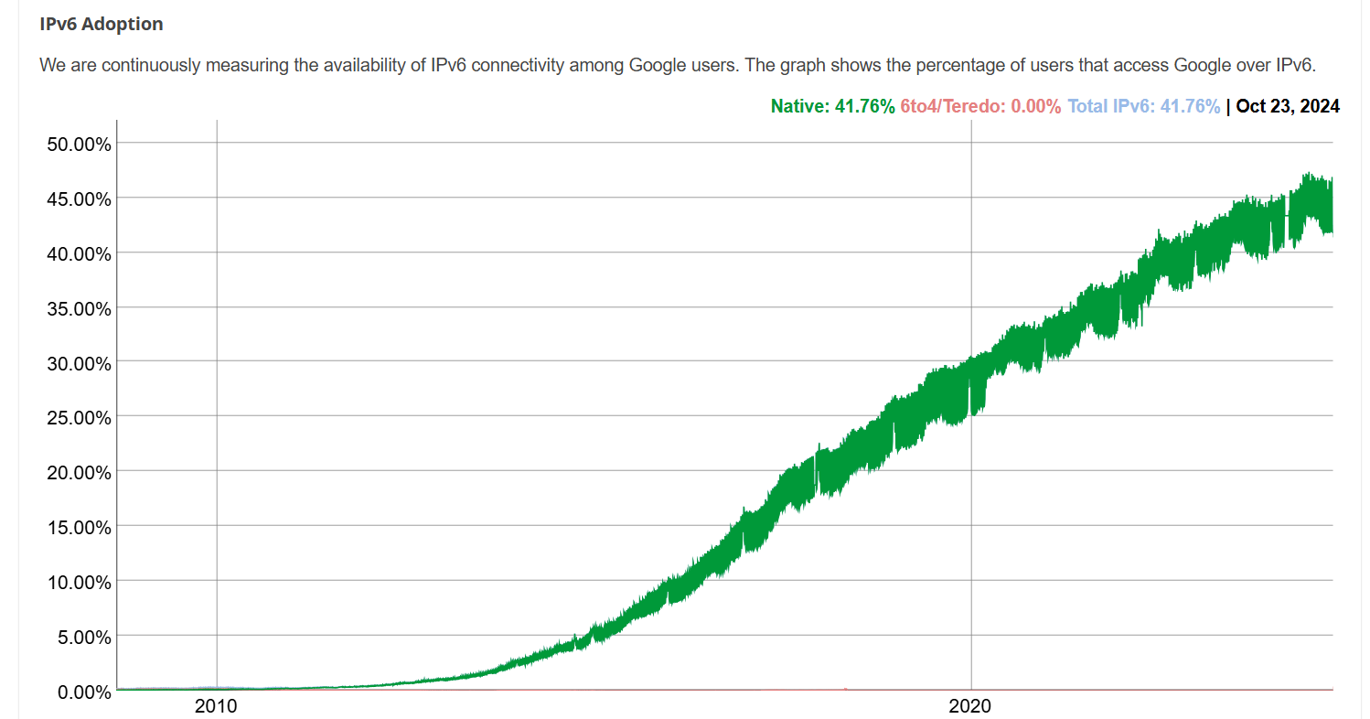
IPv6 adoption
Google¹: ~ 50% of clients access services via IPv6 (2024)
NIST: 1/3 of all US government domains are IPv6 capable

Slide 50
IPv6 adoption
Google¹: ~ 30% of clients access services via IPv6
NIST: 1/3 of all US government domains are IPv6 capable
Long (long!) time for deployment, use
25 years and counting!
think of application-level changes in last 25 years: WWW, social media, streaming media, gaming, telepresence, …
Why?
¹ https://www.google.com/intl/en/ipv6/statistics.html

Slide 51
IP addressing: last words ...
Q: how does an ISP get block of addresses?
A: ICANN: Internet Corporation for Assigned Names and Numbers http://www.icann.org/
allocates IP addresses, through 5 regional registries (RRs) (who may then allocate to local registries)
Q: are there enough 32-bit IP addresses?
ICANN allocated last chunk of IPv4 addresses to RRs in 2011
NAT helps IPv4 address space exhaustion
IPv6 has 128-bit address space
"Who the hell knew how much address space we needed?" Vint Cerf (reflecting on decision to make IPv4 address 32 bits long)
Notes:
- manages DNS root zone, including delegation of individual TLD (.com, .edu , …) management

