Slide 1

CS 456/656
Computer Networks
Lecture 1: Introduction – Part 1
Mina Tahmasbi Arashloo and Uzma Maroof
Fall 2025

Slide 2
About the instructors – Mina Tahmasbi Arashloo
I do research on computer networks.
  Specifically, software-defined and programmable networks, and network verification.
I got my PhD from Princeton University in 2019
Then, I did a post-doc at Cornell University until 2022
I joined University of Waterloo as an assistant professor in July 2022
A major part of my job is to continue doing research on computer networks
  Feel free to reach out if you want to talk about research!

Slide 3
About the instructors – Uzma Maroof
Uzma’s research area is computer network security.
  Specifically, IoT security, Internet Censorship, and applying Machine learning solutions for computer network security
She got her PhD from the University of New South Wales, Sydney, Australia, in 2023
She joined the University of Waterloo as a Postdoctoral Fellow in November 2023

Slide 4
About this course
What is a computer network?
How do modern computer networks work?
The Internet is one of the most important collections of computer networks.
So, we will use it as our guiding example throughout the course.

Slide 5
Why learn about computer networks?
Because they are everywhere!
  Every time you connect to an online service, you are sending and receiving data through multiple computer networks.
  Most large-scale online services are distributed applications that use computer networks to communicate and collectively processes millions of requests per second.
Our world is already relying on computer networks for its day-to-day operation
Our dependence on computer networks is only going to grow over time.

Slide 6
Today’s agenda
A high-level overview of computer networks
Course logistics
But before we start…

Slide 7
Territorial Acknowledgement
The University of Waterloo acknowledges that much of our work takes place on the traditional territory of the Neutral, Anishinaabeg and Haudenosaunee peoples. Our main campus is situated on the Haldimand Tract, the land granted to the Six Nations that includes six miles on each side of the Grand River. Our active work toward reconciliation takes place across our campuses through research, learning, teaching, and community building, and is centralized within the Office of Indigenous Relations.

Slide 8
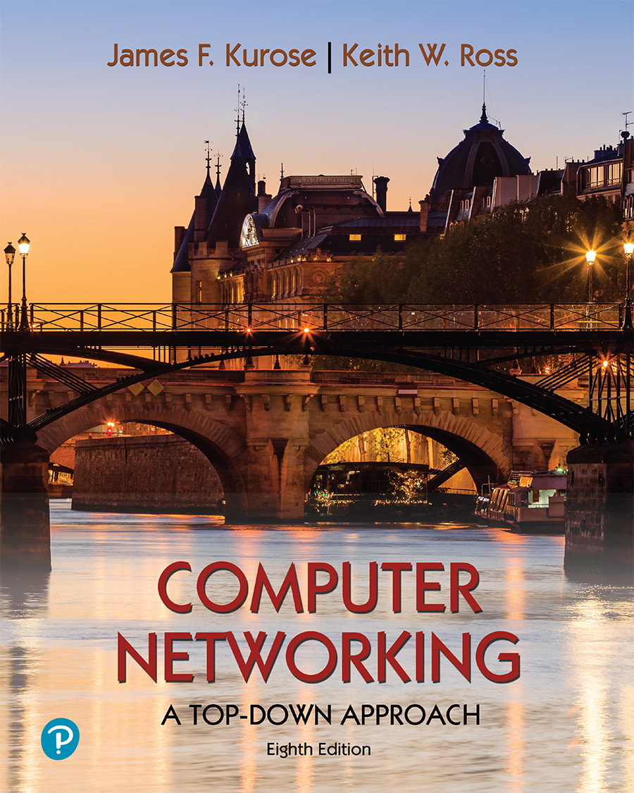
A note on the slides
Adapted from the slides that accompany this book.
All material copyright 1996-2023
J.F Kurose and K.W. Ross, All Rights Reserved
Computer Networking: A Top-Down Approach
8th edition
Jim Kurose, Keith Ross
Pearson, 2020

Slide 9
Introduction
What is a computer network?
What is the Internet?

Slide 10
Introduction
What is a computer network?
What is the Internet?

Slide 11


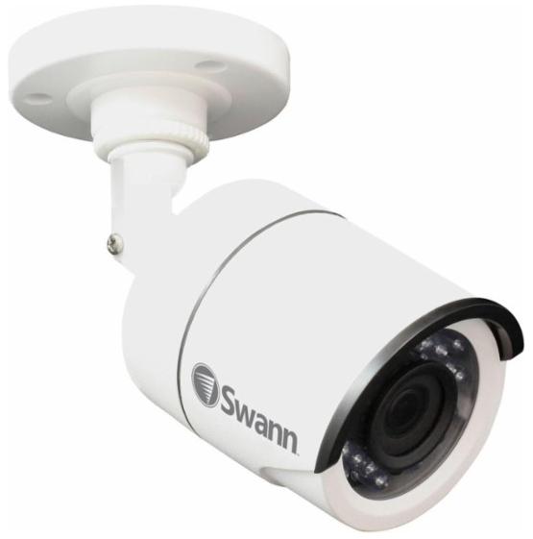
What is a computer network?
Network devices
A system that enables computers to exchange information
Hosts

Slide 12
What is a computer network?
Network devices
A system that enables computers to exchange information
The information exchange is governed by protocols.
Hosts

Slide 13
What is a protocol?
“A system of rules that explain the correct conduct and procedures to be followed in formal situations”
Notes:
Explain important points
distributed entities, exchanging messages (governed by protocols)
Time going down
go over definition of protocol (showing format, order of messages sent and received, and actions taken)
We’ll see these kinds of diagrams a lot

Slide 14


What is a protocol?
Hi
Rules for:
… specific messages sent
… specific actions taken when message received, or other events
Hi
Got the
time?
2:00
time
Notes:
Explain important points
distributed entities, exchanging messages (governed by protocols)
Time going down
go over definition of protocol (showing format, order of messages sent and received, and actions taken)
We’ll see these kinds of diagrams a lot

Slide 15
Network protocols
Network protocols are between computers (devices) rather than humans
A protocol defines:
the format and order of messages sent and received among network entities, and
actions taken on message transmission and receipt

Slide 16
Network protocols
Network protocols are between computers (devices) rather than humans
Hi
Hi
Got the
time?
2:00
time
Notes:
Explain important points
distributed entities, exchanging messages (governed by protocols)
Time going down
go over definition of protocol (showing format, order of messages sent and received, and actions taken)
We’ll see these kinds of diagrams a lot

Slide 17

Network protocols

Slide 18
Network protocols
Network protocols are between computers (devices) rather than humans
Hi
Connection
request
Hi
Connection
response
Got the
time?
GET https://uwaterloo.ca/future-students/programs
2:00
<file>
time
Notes:
Explain important points
distributed entities, exchanging messages (governed by protocols)
Time going down
go over definition of protocol (showing format, order of messages sent and received, and actions taken)
We’ll see these kinds of diagrams a lot

Slide 19
Network protocols
Network protocols are between computers (devices) rather than humans
Hi
Connection
request
Hi
Connection
response
Got the
time?
GET https://uwaterloo.ca/future-students/programs
How does the data actually get transmitted?
2:00
<file>
time
Notes:
Explain important points
distributed entities, exchanging messages (governed by protocols)
Time going down
go over definition of protocol (showing format, order of messages sent and received, and actions taken)
We’ll see these kinds of diagrams a lot

Slide 20


Packets: Data Transmission Units
Sender breaks data into smaller chunks
Over the Internet, these chunks are known as packets
Receiver receives data chunks and reassembles the data
Q: What are the benefits of transmitting data in smaller chunks?
Sender
Packetizing
Receiver
reassembling
Notes:
Error detection and correction
Better sharing of resources

Slide 21
Packets: Data Transmission Units
Sender breaks data into smaller chunks
Over the Internet, these chunks are known as packets
Receiver receives data chunks and reassembles the data
Q: What are the benefits of transmitting data in smaller chunks?
  Error detection and correction
  Better sharing of resources
  …
Sender
Packetizing
Receiver
reassembling

Slide 22
What is a computer network?
Network devices
A system that enables computers to exchange information
The information exchange is governed by protocols.
Hosts
Data is transmitted in small chunks called packets

Slide 23
Sounds simple, right?
Turns out, when you want to connect many computers, things get complicated very fast.

Slide 24

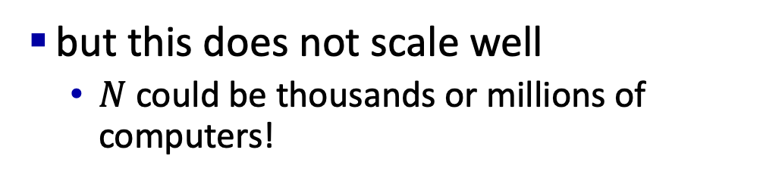
Connecting many computers
Sender
In principle, if there are $N$ computers, we can use $N(N−1)/2$ dedicated links between each pair
but this does not scale well
  $N$ could be thousands or millions of computers!
Receiver

Slide 25
Connecting many computers
Sender
Solution: Use a collection of shared network devices and links.
Receiver

Slide 26
Connecting many computers – cont.
Sender
Solution: Use a collection of shared network devices and links.
Single-”hop” becomes multi-”hop”
Switches/routers’s job is to relay the data
Q: What are the pros and cons of this approach?
Switches/routers
Receiver
Notes:
Switching cost → latency
Transmission cost is reduced but switching cost is increased: the number of transmission links (cost) is reduced but the number of switches (costs) increases

Slide 27
Communicating over a shared network
Multiple pairs of senders and receivers will use the shared devices and links simultaneously.
Ideally, we’d like
  data transfer between each pair to be done within a reasonable time.
  the network to be utilized well – i.e., not to be overwhelmed with too many simultaneous requests or be left idle for too long.

Slide 28
Communicating over a shared network
Multiple pairs of senders and receivers will use the shared devices and links simultaneously.
Ideally, we’d like
  data transfer between each pair to be done within a reasonable time.
  the network to be utilized well – i.e., not to be overwhelmed with too many simultaneous requests or be left idle for too long.
Q: what is considered “reasonable time”?

Slide 29
Communicating over a shared network
To make that happen, networking people have to solve several challenging problems:
  How to decide when a sender gets to transmit data?
  How to pick good paths for getting data from its source to its destination?
  How to adapt when a switch/router or a link fails?
  …

Slide 30
Communicating over a shared network
To make that happen, networking people have to solve several challenging problems:
  How to decide when a sender gets to transmit data?
  How to pick good paths for getting data from its source to its destination?
  How to adapt when a switch/router or a link fails?
  …
Not as straightforward as it may seem.
We’ll discuss two common solutions.

Slide 31

Solution 1: Reserve before sending
A
D1, D2, D3, and D4 are network devices.
Suppose that if $D_{i}$ is connected to $D_{j}$, it can send $X$ data units to $D_{j}$ every second.
In diagram, each link has four circuits
D1
D2
D3
D4
B

Slide 32

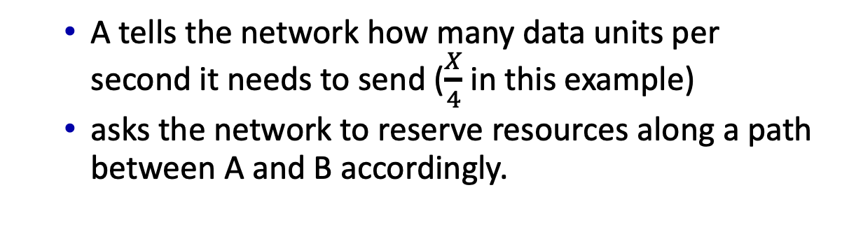
Solution 1: Reserve before sending
A
D1, D2, D3, and D4 are network devices.
Suppose that if $D_{i}$ is connected to $D_{j}$, it can send $X$ data units to $D_{j}$ every second.
In diagram, each link has four “slots”
D1
D2
When A wants to communicate with B
D3
D4
  A tells the network how many data units per second it needs to send ($\frac{X}{4}$ in this example)
  asks the network to reserve resources along a path between A and B accordingly.
B

Slide 33
Solution 1: Reserve before sending
A
To reserve resources, each device along the path records that it needs to reserve 1/4th of the capacity of its link to the next device for the data from A to B.
  call gets 2nd slot in top link and 1st slot in right link.
Once the network confirms the reservation, A can start sending.
Once A is done sending, the network can end the reservation.
D1
D2
D3
D4
B

Slide 34
Solution 1: Reserve before sending
A
Reservations are great!
While A is sending data to B, ¼ of the capacity of the top and right links is dedicated to that data transfer.
Pro: No one else can use it
Con: No one else can use it
Why is it both a pro and a con?
D1
D2
D3
D4
B

Slide 35
Solution 1: Reserve before sending
A
No sharing means dedicated resources and circuit-like (guaranteed) performance.
No sharing also means if A and B are not using the circuit, it will go unutilized.
D1
D2
D3
D4
B

Slide 36
Reserve before sending = Circuit switching
Circuit: the reserved path over the network
Switching: moving data from one switch “port” to another (more on this later)
Circuit switching is commonly used in traditional telephone networks.
There were some circuit-switching-like proposals in the early days of Internet

Slide 37
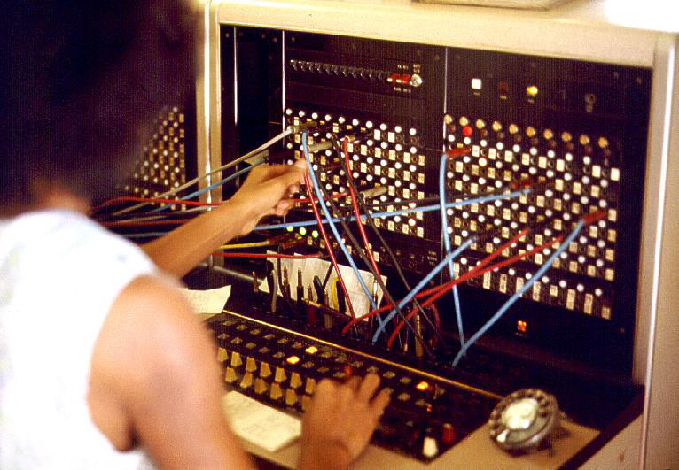
Side note – the term switching
Input
output
Calls are connected with cord pairs at a telephone switchboard.
Switching: moving data from one port/channel to another.
Notes:
Switching: moving data from one “port”/channel to another.

Slide 38
What are those “slots”?
Frequency Division Multiplexing (FDM)
optical, electromagnetic frequencies divided into (narrow) frequency bands
4 users
frequency
each call allocated its own band, can transmit at max rate of that narrow band
time
Time Division Multiplexing (TDM)
time divided into slots
frequency
each call allocated periodic slot(s), can transmit at maximum rate of (wider) frequency band (only) during its time slot(s)
time

Slide 39
Solution 2: Send on demand
The sender sends as soon as it has data to send.
Why could this be a good idea?

Slide 40
Solution 2: Send on demand
A
C
D1
D2
E
B
D3
F
A is sending data to C
B is sending data to F
D1 can send 4 “packets” to D2 every second

Slide 41
Solution 2: Send on demand
A
C
D1
D2
E
B
D3
F
A to C
B to F
1
2
3
4
Time (sec.)

Slide 42
Solution 2: Send on demand
A
C
D1
D2
E
B
D3
F
A to C
B to F
D1 to D2 – Sol 1
1
2
3
4
Reserve before sending
Time (sec.)

Slide 43
Solution 2: Send on demand
A
C
D1
D2
E
B
D3
F
A to C
Why can we only reserve a circuit for one of them?
B to F
D1 to D2 – Sol 1
1
2
3
4
Time (sec.)

Slide 44
Solution 2: Send on demand
A
C
D1
D2
E
B
D3
F
Wasted capacity
A to C
Why can we only reserve a circuit for one of them?
B to F
D1 to D2 – Sol 1
1
2
3
4
Time (sec.)

Slide 45
Solution 2: Send on demand
A
C
D1
D2
E
B
D3
F
Send on demand
A to C
Can accommodate both!
B to F
D1 to D2 – Sol 2
D1 to D2 – Sol 1
1
2
3
4
Reserve before sending
Time (sec.)

Slide 46
Solution 2: Send on demand
A
C
D1
D2
E
B
D3
F
A to C
B to F
D1 to D2 – Sol 2
1
2
3
4
Time (sec.)

Slide 47
Solution 2: Send on demand
A
C
D1
D2
E
B
D3
F
A to C
Can still accommodate both but
blue has to wait longer
B to F
D1 to D2 – Sol 2
1
2
3
4
Time (sec.)

Slide 48
Solution 2: Send on demand
A
C
D1
D2
E
B
D3
F
A to C
B to F
D1 to D2 – Sol 2
1
2
3
4
Time (sec.)

Slide 49
Solution 2: Send on demand
A
C
D1
D2
E
B
D3
F
A to C
D1 has to hold on to these for a while until it has available slots to send them out.
B to F
If D1 runs out of memory, these will be lost…
D1 to D2 – Sol 2
1
2
3
4
Time (sec.)

Slide 50
Send on demand = Packet Switching
No reservation needed.
It allows more senders to send data simultaneously over the network.
As long as their transmission pattern is “bursty” enough, the probability that all of them send at the same time is quite low, so the network should be able to handle that.
  Statistical multiplexing
This is the approach used in the Internet.

Slide 51
Circuit switching vs. Packet switching
Circuit switching
Network resources (e.g., link capacity) divided into “pieces”
Dedicated end-to-end resources
Circuit-like guaranteed performance
Packet switching
Each packet uses full link capacity
Packets from different users share network resources
  Resources used as needed
Resource contention
  Congestion: packets queue in network devices, and wait for link use

Slide 52
What you need to know about packet switching vs circuit switching
You should understand and be able to explain the difference between packet switching and circuit switching with examples.

Slide 53
From this point on – Packet switching
Unless stated otherwise, we assume a packet-switched network.
This is because most networks that you interact with, including the Internet, use packet switching.

Slide 54
Communicating over a shared network
To make that happen, networking people have to solve several challenging problems:
  How to decide when a sender gets to transmit data?
  How to pick good paths for getting data from its source to its destination?
  How to adapt when a switch/router or a link fails?
  …
We’ll talk about the rest and the Internet, next time

Slide 55
Questions?

Slide 56
Course logistics – where to get what ☺
The course webpage
  https://mina.arashloo.net/courses/CS456-F25/index.html
  Course outline, tentative schedule, slides, policies, and references
UWaterloo outline
  Course outline, policies
LEARN
  Announcements, slides, quizzes, assignments
Piazza
  Questions and discussions

Slide 57
Course logistics – Lectures and office hours
There are two sections in the course.
  They will cover the same overall material by the end of the term.
  But they may not be fully in sync.
  Try to attend lectures of the same section throughout the term.
Instructor office hours are generally for questions about the lectures and other topics related to computer networks
  Mina Tahmasbi Arashloo: Tuesdays, 5-6pm
  Uzma Maroof: Wednesdays, 4:30-5:30pm
  See LEARN for locations
TA office hours are generally for questions about the assignments
  Time and location will be announced on LEARN

Slide 58
Course logistics – Readings
Readings are optional and from the following sources
  Computer Networking, A Top-Down Approach, James Kurose & Keith Ross, Pearson, 8th Edition (7th Edition is also fine).
  Research papers, blog posts, and platforms related to computer networks.
Links to the latter will be posted on the course webpage

Slide 59
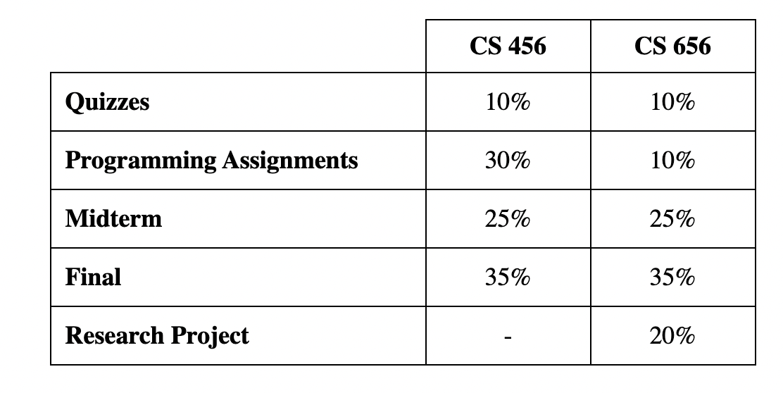
Course logistics – Assessment

Slide 60
Course logistics – Quizzes
Helps you assess your understanding of the course material
Help us as your instructors to pinpoint subjects that need extra discussion in the class.
Every week that we have lectures, a quiz will be posted on LEARN on Thursday that week at 8PM EST.
You have until Sunday at 11:59PM EST to complete the quiz.
  There are a few exceptions that will be announced the week of the quiz.

Slide 61
Course logistics – Quizzes
Questions are multiple-choice and are about the material covered in class that week.
You will have unlimited attempts. Hopefully, this helps you focus on your learning of the material without having to worry about your grade.
A missed quiz cannot be retaken and doctor's note is not accepted for missed quizzes.
You can miss two quizzes without it affecting your grade.
  There is a total of 10 quizzes → 8 quizzes worth 10%

Slide 62
Course logistics – Programming Assignments (CS 456)
There are three programming assignments, each counting as 10% of your final grade.
Assignment specifications will be posted on LEARN.
Assignments are to be completed individually and submitted to the appropriate Dropbox on LEARN.
You have a total of four late days for the whole term.

Slide 63
Course logistics – Programming Assignments (CS 456)
Use your late days to accommodate unexpected situations. No questions will be asked.
  Examples of unexpected situations include your internet connection being down right before the deadline or forgetting or missing the deadline.
Your four late days are for the whole term, not per assignment.
  E.g.: If you use 2 late days for assignment 1, you have only 2 late days left to use for the rest of the assignments.

Slide 64
Course logistics – Programming Assignments (CS 456)
Late days are tracked daily, not hourly.
  E.g.: If an assignment is due on Thursday at 11:59pm, and you turn it in the next day (Friday) at noon, you have used one of your late days.
The four late days include the self-declared short-term absence
  E.g. if you have used 1 late day, and declare a two-day short-term absence, you will have 1 late day left for the rest of the term.
No extensions are granted if you have no late days left, so plan ahead and use them carefully.
  E.g.: If you have no late days left and submit the assignment after the deadline, you will not receive any points for the assignment

Slide 65
Course logistics – Programming Assignments (CS 656)
Choose two of the three to complete.
Each will count as 5% of your grade.
The rest of the logistics is the same as CS 456.

Slide 66
Course logistics – Exams
Exams will be solely based on the materials presented in the class
  this includes the parts that may not necessarily be covered in the textbook or the slides.
Exams are closed-book.
  You can bring 5 pages of double-sided notes
The midterm exam is on Thursday, Oct 23, 7 to 8:50 PM.
Date, time, and location of the final exam will be announced by the Registrar's Office.

Slide 67
Course logistics – Exams
Midterm and final have to be passed, in the aggregate, in order to pass the course. That is, [(Midterm*25) + (Final*35)] / 60 >= 50%
In the case of a missed exam, a medical certificate or doctor's note must be uploaded to the university's online portal.
  Please refer to the course outline for information about acceptable certificates and doctor’s notes.

Slide 68
Course logistics – Midterm and self-declared absence
If you miss the midterm due to an official self-declared short-term absence, the weight will be shifted to the final exam.
The final exam will be counted as 60% of your grade.
You need to score at least 50% in the final exam to pass the course.

Slide 69
Course logistics – Research Project (CS 656)
Students taking CS 656 are expected to work individually on original research projects related to computer networks.
There are three deliverables:
  Proposal (5%): One page, due by the end of week 3. Please reach out to set up a time to discuss project ideas.
  Progress Report (3%): Two pages, due a month after the proposal
  Online Presentation (3%): ~two weeks before final report, with instructors
  Final Report (9%): 6-page conference-style paper, due at the end of the term
Notes:
Let the waitlisted students know they will here from us soon (by following Friday)

Slide 70
Course logistics – Q&A Policy
We strongly encourage you to ask questions! However, this is a large class.
We may not be able to answer duplicate questions
  i.e., topics that are already discussed in the course outline, questions already answered on Piazza, or questions already answered in FAQs.
Please check the course outline, the course FAQs, assignment FAQs, and Piazza before posting your question.

Slide 71
Course logistics – Q&A Policy continued
We will do our best to answer your questions as soon as possible, but
  it may take the teaching team up to 2 business days to answer emails and Piazza questions.
Please take that into account when planning when to start working on assignments and studying for the exams.
  Specifically, keep in mind that the teaching team may not be able to get to last-minute close-to-deadline questions outside office hours.
These two policies are in place to ensure the teaching team can effectively answer everyone’s questions in a timely manner.

Slide 72
Course logistics – Attendance
Attendance is not mandatory but we strongly encourage you to attend the lectures.
While the slide will be available online, they are mostly intended as teaching aids for the lectures as opposed to detailed lecture notes.
As such, they do not necessarily include all the details of the topics discussed in this course.

Slide 73
Course logistics – Generative AI
Like any other tool, it should be used carefully and in a mindful, responsible manner.
If you decide to use it in your programming assignments, it needs to be with proper documentation, citation, and acknowledgement.
  Details will be outlines in the assignment instructions.
You can find pointers to university guidelines and recommendations about using generative AI in the course outline.

Slide 74
Course logistics – Generative AI
At the end of the day, you are accountable for the content and accuracy of your work, including any supported by generative AI.
So, be mindful about where, how, and to what extent you use generative AI in your work.

Slide 75
Course logistics - Other
Please make sure to read the outline carefully regarding
  Mental health
  Diversity
  Academic integrity
  Special accommodations
No quiz this week.

Slide 76
Final remarks
It gets quite boring to have a one-way conversation for 80 minutes ☺
Your questions and thoughts are always welcome!
Computer networks are a corner stone of modern society and I’m looking forward to go over the in and outs of how they work with all of you this term.

